Slide 1
Chapter 3
Conceptual Database Design, E-R modeling

Slide 2
Project Phase 1
Due: April 17th
Requirement Analysis:
All Requirements should be included
Conceptual Design:
Complete ER diagram
Report: Not less than 15 pages

Slide 3
Overview of Database Design Process
Two main activities:
Database design
Applications design
Focus in this chapter on conceptual database design
To design the conceptual schema for a database application
Applications design focuses on the programs and interfaces that access the database
Generally considered part of software engineering

Slide 4
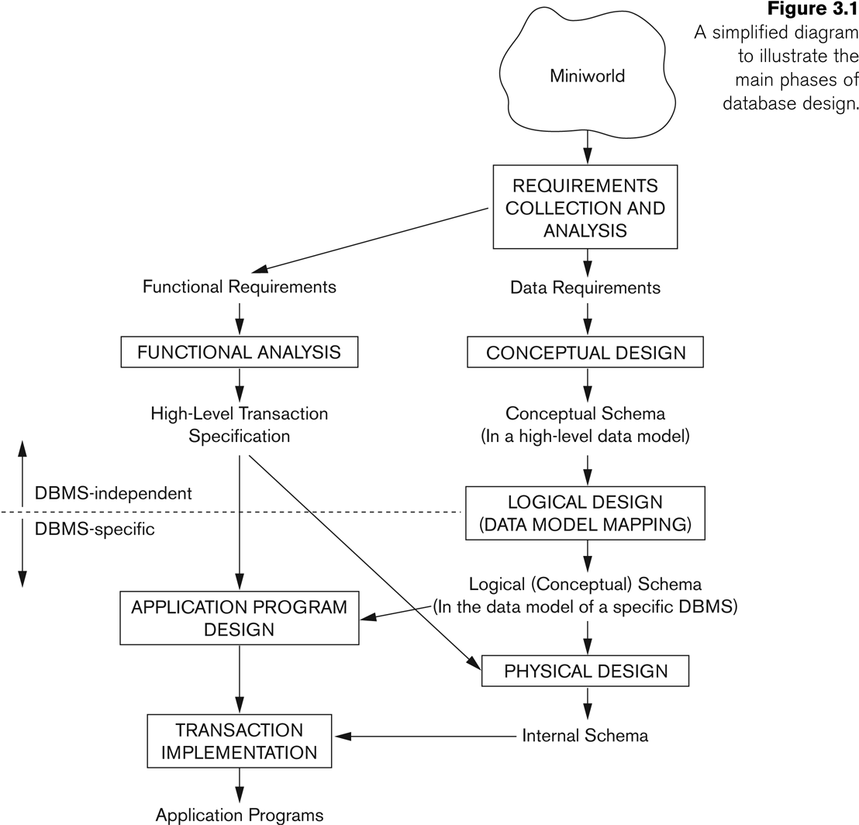
Overview of Database Design Process

Slide 5
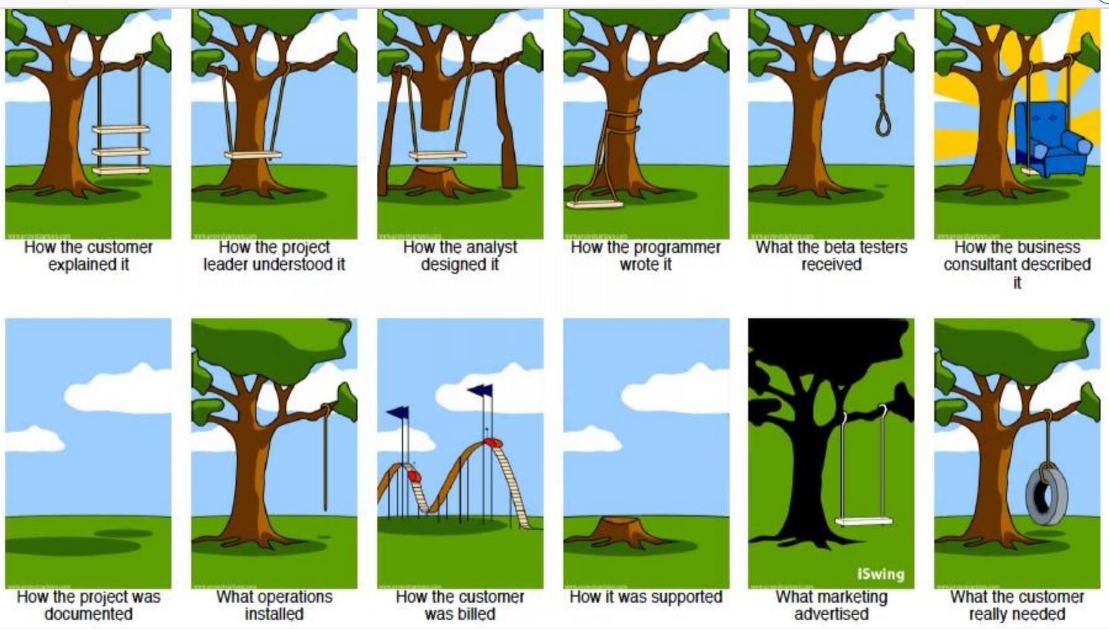
Software Project …

Slide 6
Methodologies for Conceptual Design
Entity Relationship (ER) Diagrams
Enhanced Entity Relationship (EER) Diagrams
Use of Design Tools in industry for designing and documenting large scale designs
The UML (Unified Modeling Language) Class Diagrams are popular in industry to document conceptual database designs

Slide 7
Example COMPANY Database
We need to create a database schema design based on the following (simplified) requirements of the COMPANY Database:
The company is organized into DEPARTMENTs. Each department has a name, number and an employee who manages the department. We keep track of the start date of the department manager. A department may have several locations.
Each department controls a number of PROJECTs. Each project has a unique name, unique number and is located at a single location.

Slide 8
Example COMPANY Database (Continued)
The database will store each EMPLOYEE’s social security number, address, salary, sex, and birthdate.
Each employee works for one department but may work on several projects.
The DB will keep track of the number of hours per week that an employee currently works on each project.
It is required to keep track of the direct supervisor of each employee.
Each employee may have a number of DEPENDENTs.
For each dependent, the DB keeps a record of name, sex, birthdate, and relationship to the employee.

Slide 9
ER Model Concepts
Entities and Attributes
Entity is a basic concept for the ER model. Entities are specific things or objects in the mini-world that are represented in the database.
For example the EMPLOYEE John Smith, the Research DEPARTMENT, the ProductX PROJECT
Attributes are properties used to describe an entity.
For example an EMPLOYEE entity may have the attributes Name, SSN, Address, Sex, BirthDate
A specific entity will have a value for each of its attributes.
For example a specific employee entity may have Name='John Smith', SSN='123456789', Address ='731, Fondren, Houston, TX', Sex='M', BirthDate='09-JAN-55‘
Each attribute has a value set (or data type) associated with it – e.g. integer, string, date, enumerated type, …

Slide 10
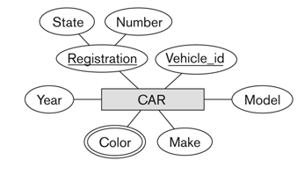
Types of Attributes (1)
Simple
Each entity has a single atomic value for the attribute. For example, SSN or Sex.
Composite
The attribute may be composed of several components.
For example:
Address(Apt#, House#, Street, City, State, ZipCode, Country), or
Name(FirstName, MiddleName, LastName).
Composition may form a hierarchy where some components are themselves composite.
Multi-valued
An entity may have multiple values for that attribute. For example, Color of a CAR or PreviousDegrees of a STUDENT.
Denoted as {Color} or {PreviousDegrees}.

Slide 11
Types of Attributes (2)
In general, composite and multi-valued attributes may be nested arbitrarily to any number of levels, although this is rare.
For example, PreviousDegrees of a STUDENT is a composite multi-valued attribute denoted by {PreviousDegrees (College, Year, Degree, Field)}
Multiple PreviousDegrees values can exist
Each has four subcomponent attributes:
College, Year, Degree, Field
{PreviousDegrees (College, Year, Degree, Field)}

Slide 12
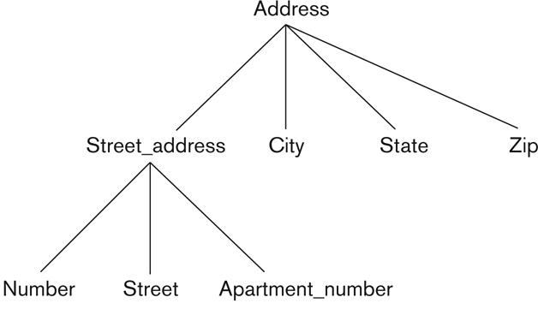
Example of a composite attribute
Address(Street_address(Number,Street,Apartment_number),City,State,Zip))

Slide 13
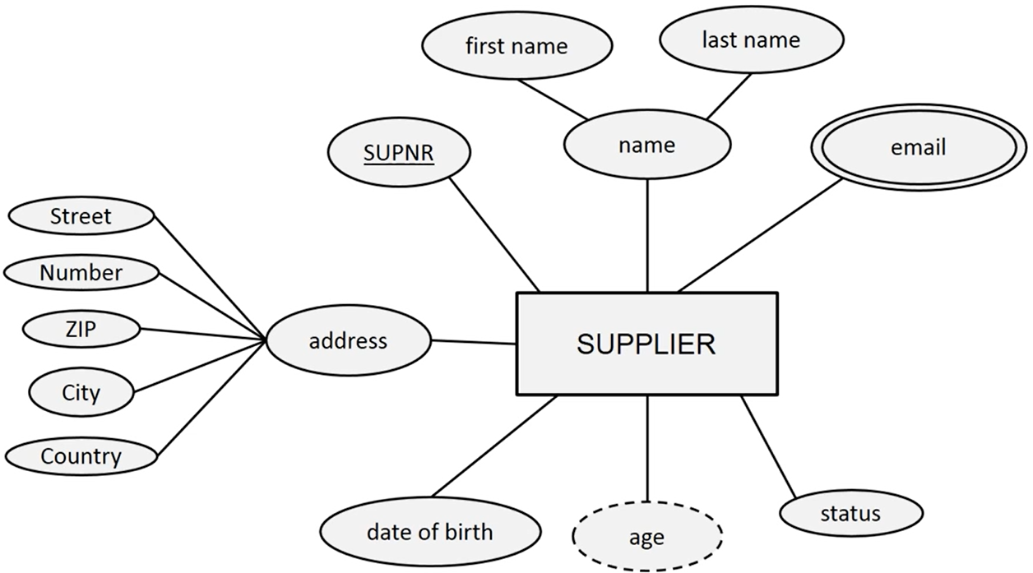
State the type of each attribute
Exercise

Slide 14
Complex Attributes
In general, composite and multivalued attributes can be nested arbitrarily to form a complex attribute.
nested by grouping components of a composite attribute between parentheses ( ) and separating the components with commas, and
by displaying multivalued attributes between braces { }.
For example, if a person can have more than one residence and each residence can have a single address and multiple phones, an attribute Address_phone for a person can be specified as
{Address_phone( {Phone(Area_code, Phone_number)}, Address(Street_address (Number, Street, Apartment_number) ,City, State, Zip) )}

Slide 15
Stored versus Derived Attributes
Some attribute values can be derived from related entities;
The attribute Number_of_employees of a DEPARTMENT entity can be derived by counting the number of employees related to (working for) that department.
In some cases, two (or more) attribute values are related
The Age and Birth_date attributes of a person.
The value of Age can be determined from the current (today’s) date and the value of that person’s Birth_date.
The Age attribute is hence called a derived attribute and Birth_date attribute is a stored attribute.

Slide 16
Entity Types and Key Attributes (1)
Entities with the same basic attributes are grouped or typed into an entity type.
For example, the entity type EMPLOYEE and PROJECT.
An attribute of an entity type for which each entity must have a unique value is called a key attribute of the entity type.
For example, SSN of EMPLOYEE.
A key attribute may be composite.
VehicleTagNumber is a key of the CAR entity type with components (Number, State)
An entity type may have more than one key.
The CAR entity type may have two keys:
VehicleIdentificationNumber (popularly called VIN)
VehicleTagNumber (Number, State), aka license plate number.
Each key is underlined (Note: this is different from the relational schema where only one “primary key is underlined).

Slide 17
Entity Set
Each entity type will have a collection of entities stored in the database called the entity set or sometimes entity collection
Entity set is the current state of the entities of that type that are stored in the database

Slide 18
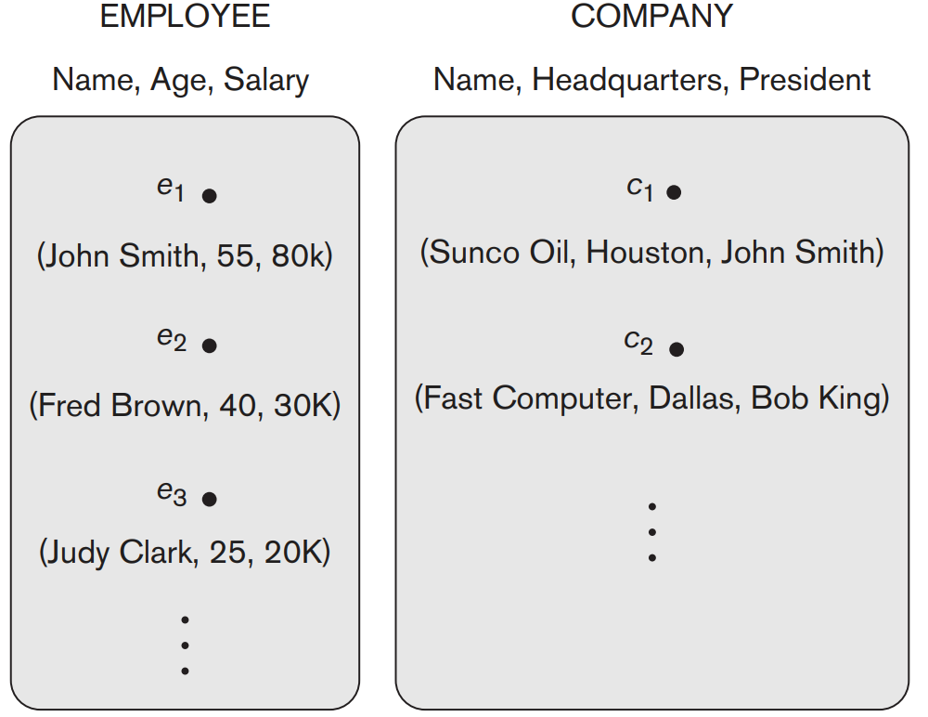
Entity Set
Each entity type will have a collection of entities stored in the database called the entity set or sometimes entity collection
Example

Slide 19
Value Sets (Domains) of Attributes
Each simple attribute is associated with a value set
E.g., Lastname has a value which is a character string of upto 15 characters, say
Date has a value consisting of MM-DD-YYYY where each letter is an integer
A value set specifies the set of values associated with an attribute
Example: if the range of ages allowed for employees is between 16 and 70, the value set of the Age attribute is the set of integer numbers between 16 and 70.

Slide 20
Attributes and Value Sets
Value sets are similar to data types in most programming languages – e.g., integer, character (n), real, bit
Mathematically, an attribute A for an entity type E whose value set is V is defined as a function
A : E → P(V)
Where P(V) indicates a power set (which means all possible subsets) of V. The above definition covers simple and multivalued attributes.
We refer to the value of attribute A for entity e as A(e).

Slide 21
Displaying an Entity type
In ER diagrams, an entity type is displayed in a rectangular box
Attributes are displayed in ovals
Each attribute is connected to its entity type
Components of a composite attribute are connected to the oval representing the composite attribute
Each key attribute is underlined
Multivalued attributes displayed in double ovals

Slide 22
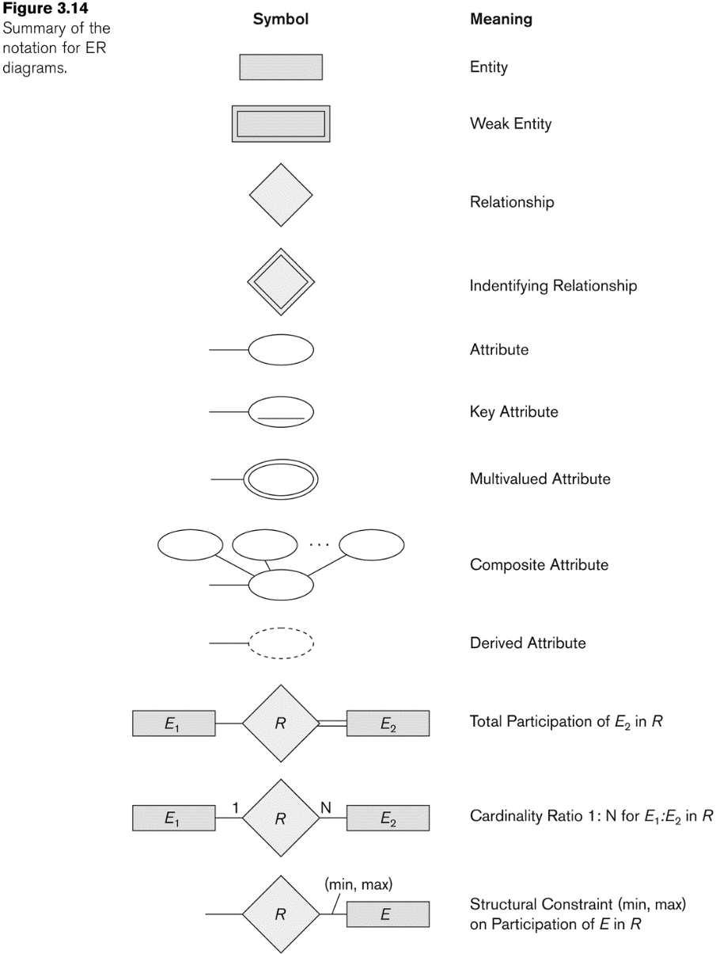
NOTATION for ER Diagrams

Slide 23
NOTATION for ER Diagrams

Slide 24
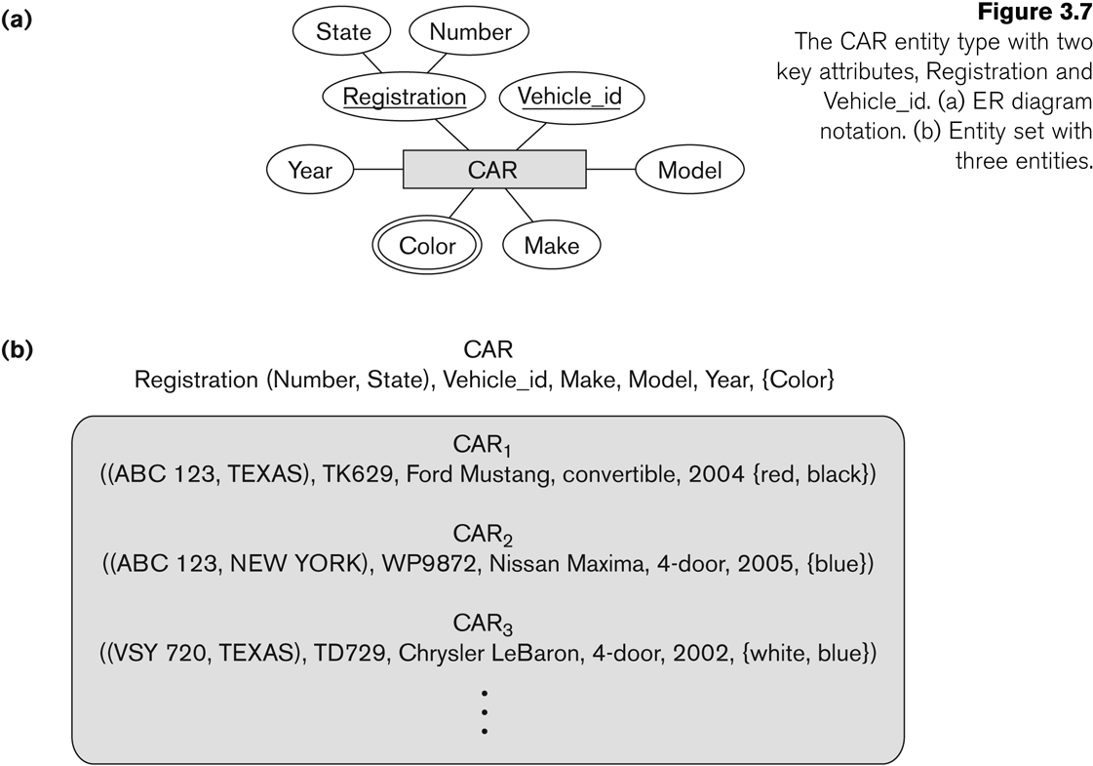
Exercise
Entity Type CAR with two keys
A corresponding Entity Set

Slide 25
Example COMPANY Database
We need to create a database schema design based on the following (simplified) requirements of the COMPANY Database:
The company is organized into DEPARTMENTs. Each department has a name, number and an employee who manages the department. We keep track of the start date of the department manager. A department may have several locations.
Each department controls a number of PROJECTs. Each project has a unique name, unique number and is located at a single location.

Slide 26
Initial Conceptual Design of Entity Types for the COMPANY Database Schema
Based on the requirements, we can identify four initial entity types in the COMPANY database:
DEPARTMENT
PROJECT
EMPLOYEE
DEPENDENT
Their initial conceptual design is shown on the following slide
The initial attributes shown are derived from the requirements description

Slide 27
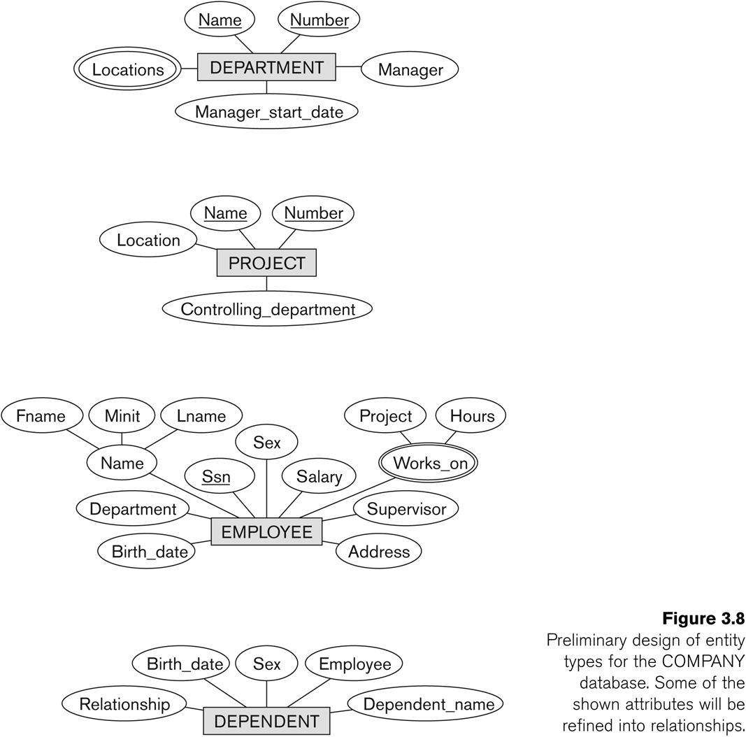
Initial (Preliminary) Design of Entity Types

Slide 28
Initial (Preliminary) Design of Entity Types

Slide 29
Initial (Preliminary) Design of Entity Types

Slide 30
Refining the initial design by introducing relationships
The initial design is typically not complete
Some aspects in the requirements will be represented as relationships
ER model has three main concepts:
Entities (and their entity types and entity sets)
Attributes (simple, composite, multivalued)
Relationships (and their relationship types and relationship sets)
We introduce relationship concepts next

Slide 31
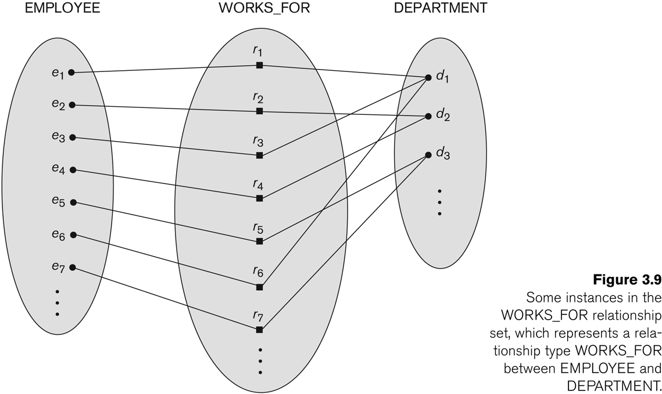
Relationship instances of the WORKS_FOR N:1 relationship between EMPLOYEE and DEPARTMENT

Slide 32
Relationships and Relationship Types (1)
A relationship relates two or more distinct entities with a specific meaning.
For example
EMPLOYEE John Smith works on the ProductX PROJECT, or
EMPLOYEE Franklin Wong manages the Research DEPARTMENT.

Slide 33
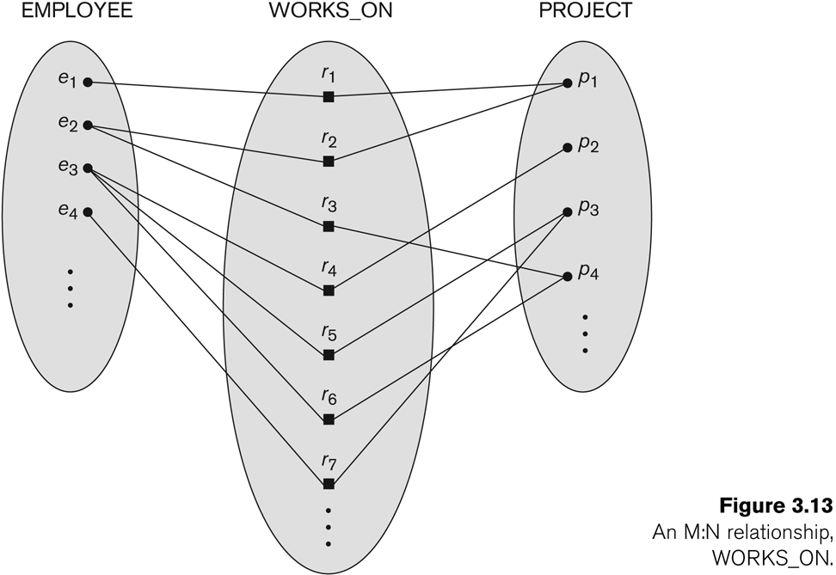
Relationship instances of the M:N WORKS_ON relationship between EMPLOYEE and PROJECT

Slide 34
Relationships and Relationship Types (1)
Relationships of the same type are grouped or typed into a relationship type.
For example, the WORKS_ON relationship type in which EMPLOYEEs and PROJECTs participate, or the MANAGES relationship type in which EMPLOYEEs and DEPARTMENTs participate.
The degree of a relationship type is the number of participating entity types.
Both MANAGES and WORKS_ON are binary relationships.

Slide 35
Relationship type vs. relationship set (1)
Relationship Type:
Is the schema description of a relationship
Identifies the relationship name and the participating entity types
Also identifies certain relationship constraints
Relationship Set:
The current set of relationship instances represented in the database
The current state of a relationship type

Slide 36
Relationship type vs. relationship set (2)
Previous figures displayed the relationship sets
Each instance in the set relates individual participating entities – one from each participating entity type
In ER diagrams, we represent the relationship type as follows:
Diamond-shaped box is used to display a relationship type
Connected to the participating entity types via straight lines
Note that the relationship type is not shown with an arrow. The name should be typically be readable from left to right and top to bottom.

Slide 37
Refining the COMPANY database schema by introducing relationships
By examining the requirements, six relationship types are identified
All are binary relationships( degree 2)
Listed below with their participating entity types:
WORKS_FOR (between EMPLOYEE, DEPARTMENT)
MANAGES (also between EMPLOYEE, DEPARTMENT)
CONTROLS (between DEPARTMENT, PROJECT)
WORKS_ON (between EMPLOYEE, PROJECT)
SUPERVISION (between EMPLOYEE (as subordinate), EMPLOYEE (as supervisor))
DEPENDENTS_OF (between EMPLOYEE, DEPENDENT)

Slide 38
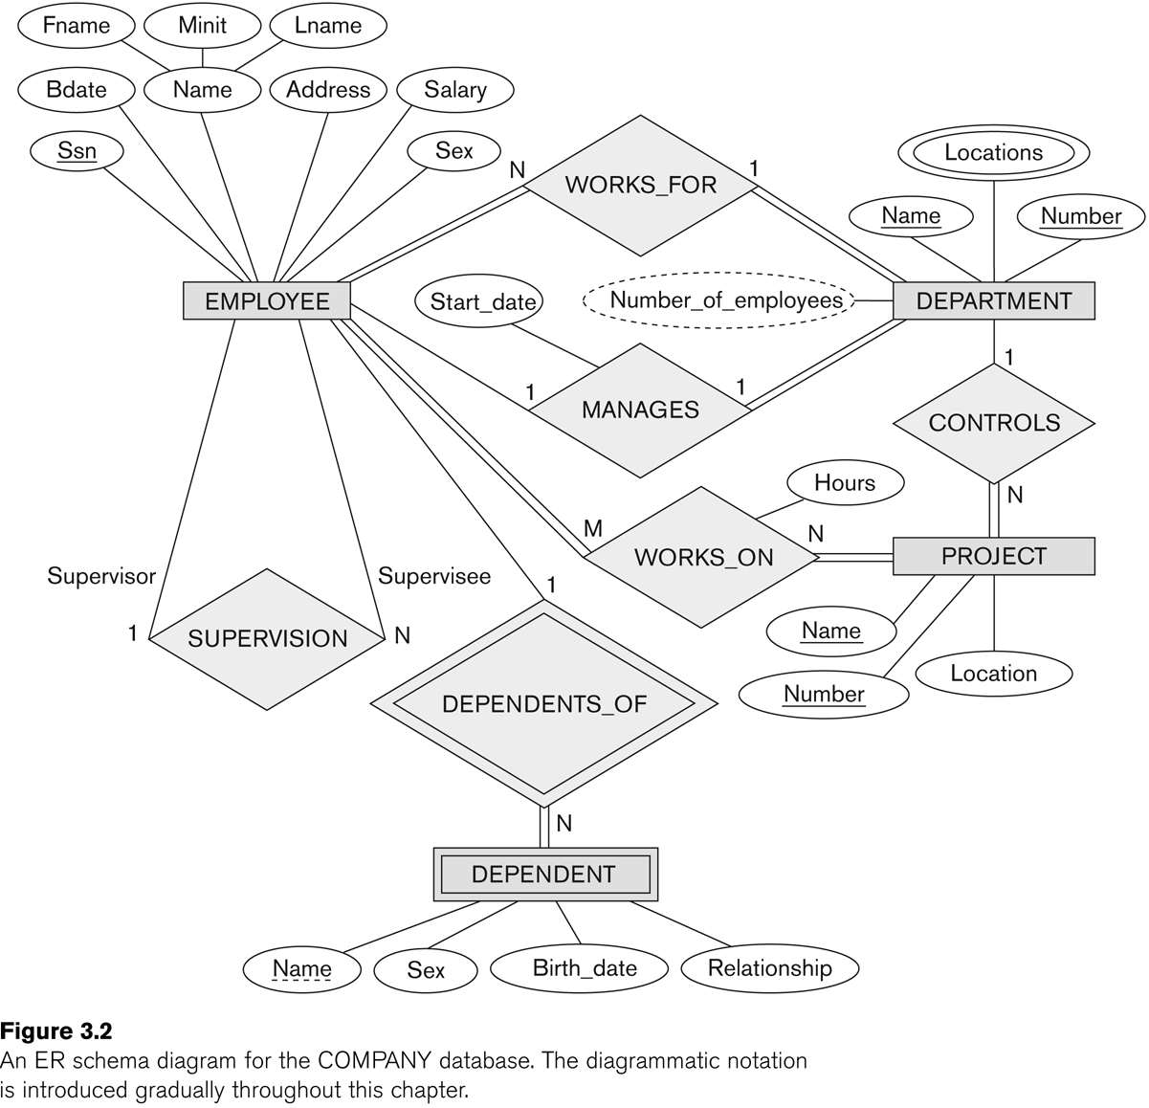
ER DIAGRAM – Relationship Types are: WORKS_FOR, MANAGES, WORKS_ON, CONTROLS, SUPERVISION, DEPENDENTS_OF

Slide 39
Discussion on Relationship Types
In the refined design, some attributes from the initial entity types are refined into relationships:
Manager of DEPARTMENT -> MANAGES
Works_on of EMPLOYEE -> WORKS_ON
Department of EMPLOYEE -> WORKS_FOR
etc
In general, more than one relationship type can exist between the same participating entity types
MANAGES and WORKS_FOR are distinct relationship types between EMPLOYEE and DEPARTMENT
Different meanings and different relationship instances.

Slide 40
Discussion on Relationship Types
In general, more than one relationship type can exist between the same participating entity types
MANAGES and WORKS_FOR are distinct relationship types between EMPLOYEE and DEPARTMENT
Different meanings and different relationship instances.

Slide 41
Constraints on Relationships
Constraints on Relationship Types
(Also known as ratio constraints)
Cardinality Ratio (specifies maximum participation)
One-to-one (1:1)
One-to-many (1:N) or Many-to-one (N:1)
Many-to-many (M:N)
Existence Dependency Constraint (specifies minimum participation) (also called participation constraint)
zero (optional participation, not existence-dependent)
one or more (mandatory participation, existence-dependent)

Slide 42
Many-to-one (N:1) Relationship

Slide 43
Many-to-many (M:N) Relationship

Slide 44
Recursive Relationship Type
A relationship type between the same participating entity type in distinct roles
Also called a self-referencing relationship type.
Example: the SUPERVISION relationship
EMPLOYEE participates twice in two distinct roles:
supervisor (or boss) role
supervisee (or subordinate) role
Each relationship instance relates two distinct EMPLOYEE entities:
One employee in supervisor role
One employee in supervisee role

Slide 45
Displaying a recursive relationship
In a recursive relationship type.
Both participations are same entity type in different roles.
For example, SUPERVISION relationships between EMPLOYEE (in role of supervisor or boss) and (another) EMPLOYEE (in role of subordinate or worker).
In following figure, first role participation labeled with 1 and second role participation labeled with 2.
In ER diagram, need to display role names to distinguish participations.

Slide 46
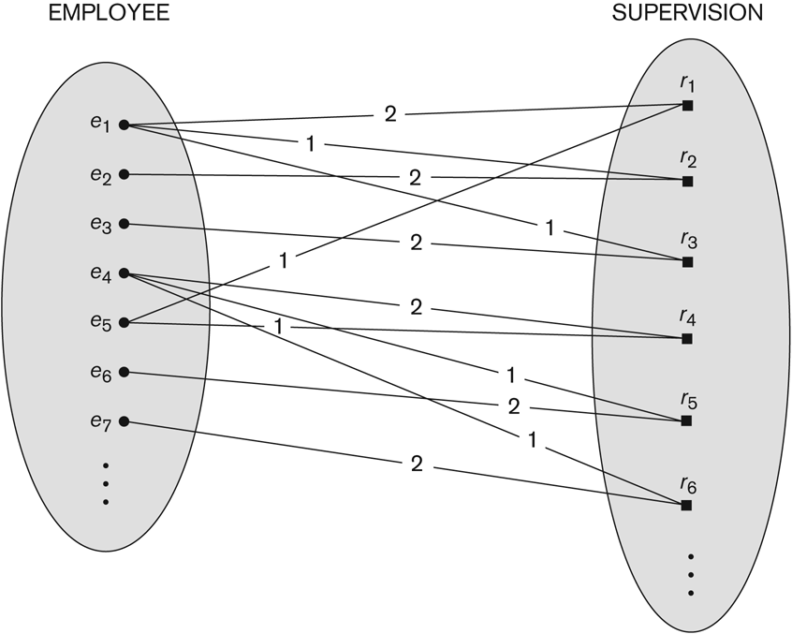
A Recursive Relationship Supervision
Employee in (1) supervisor role
(2) subordinate role

Slide 47
Recursive Relationship Type is: SUPERVISION (participation role names are shown)

Slide 48
Weak Entity Types
An entity that does not have a key attribute and that is identification-dependent on another entity type.
A weak entity must participate in an identifying relationship type with an owner or identifying entity type
Entities are identified by the combination of:
A partial key of the weak entity type
The particular entity they are related to in the identifying relationship type
Example:
A DEPENDENT entity is identified by the dependent’s first name, and the specific EMPLOYEE with whom the dependent is related
Name of DEPENDENT is the partial key
DEPENDENT is a weak entity type
EMPLOYEE is its identifying entity type via the identifying relationship type DEPENDENT_OF

Slide 49
Weak Entity Types
Example:
A DEPENDENT entity is identified by the dependent’s first name, and the specific EMPLOYEE with whom the dependent is related
Name of DEPENDENT is the partial key
DEPENDENT is a weak entity type
EMPLOYEE is its identifying entity type via the identifying relationship type DEPENDENT_OF

Slide 50
Attributes of Relationship types
A relationship type can have attributes:
For example, HoursPerWeek of WORKS_ON
Its value for each relationship instance describes the number of hours per week that an EMPLOYEE works on a PROJECT.
A value of HoursPerWeek depends on a particular (employee, project) combination
Most relationship attributes are used with M:N relationships
In 1:N relationships, they can be transferred to the entity type on the N-side of the relationship

Slide 51
Example Attribute of a Relationship Type: Hours of WORKS_ON

Slide 52
Notation for Constraints on Relationships
Cardinality ratio (of a binary relationship): 1:1, 1:N, N:1, or M:N
Shown by placing appropriate numbers on the relationship edges.
Participation constraint (on each participating entity type): total (called existence dependency) or partial.
Total shown by double line, partial by single line.
NOTE: These are easy to specify for Binary Relationship Types.

Slide 53
Alternative (min, max) notation for relationship structural constraints:
Specified on each participation of an entity type E in a relationship type R
Specifies that each entity e in E participates in at least min and at most max relationship instances in R
Default (no constraint): min=0, max=n (signifying no limit)
Must have min ≤ max, min≥0, max ≥1
Derived from the knowledge of mini-world constraints
Examples:
A department has exactly one manager and an employee can manage at most one department.
Specify (0,1) for participation of EMPLOYEE in MANAGES
Specify (1,1) for participation of DEPARTMENT in MANAGES
An employee can work for exactly one department, but a department can have any number of employees.
Specify (1,1) for participation of EMPLOYEE in WORKS_FOR
Specify (0,n) for participation of DEPARTMENT in WORKS_FOR

Slide 54
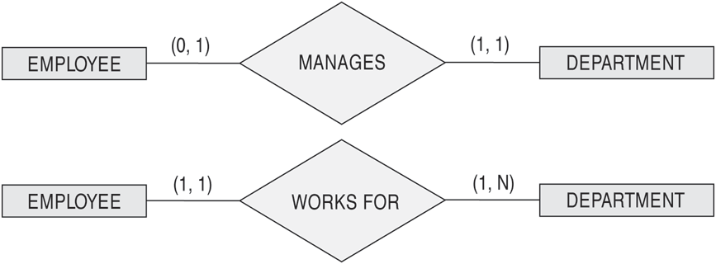
The (min, max) notation for relationship constraints
Read the min, max numbers next to the entity type and looking away from the entity type
A department has exactly one manager and an employee can manage at most one department.
An employee can work for exactly one department, but a department can have any number of employees.

Slide 55
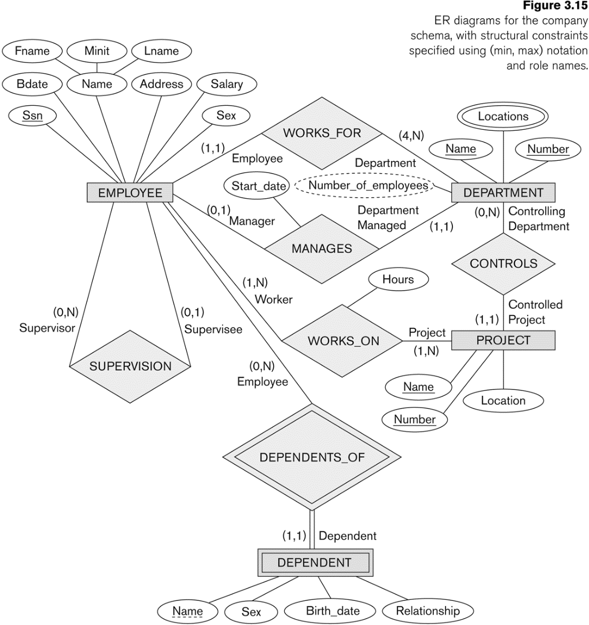
COMPANY ER Schema Diagram using (min, max) notation

Slide 56
Alternative diagrammatic notation
ER diagrams is one popular example for displaying database schemas
Many other notations exist in the literature and in various database design and modeling tools
UML class diagrams is representative of another way of displaying ER concepts that is used in several commercial design tools

Slide 57
Exercise

Slide 58
Exercise

Slide 59
UML class diagrams
Represent classes (similar to entity types) as large rounded boxes with three sections:
Top section includes entity type (class) name
Second section includes attributes
Third section includes class operations (operations are not in basic ER model)
Relationships (called associations) represented as lines connecting the classes
Other UML terminology also differs from ER terminology
Used in database design and object-oriented software design
UML has many other types of diagrams for software design

Slide 60
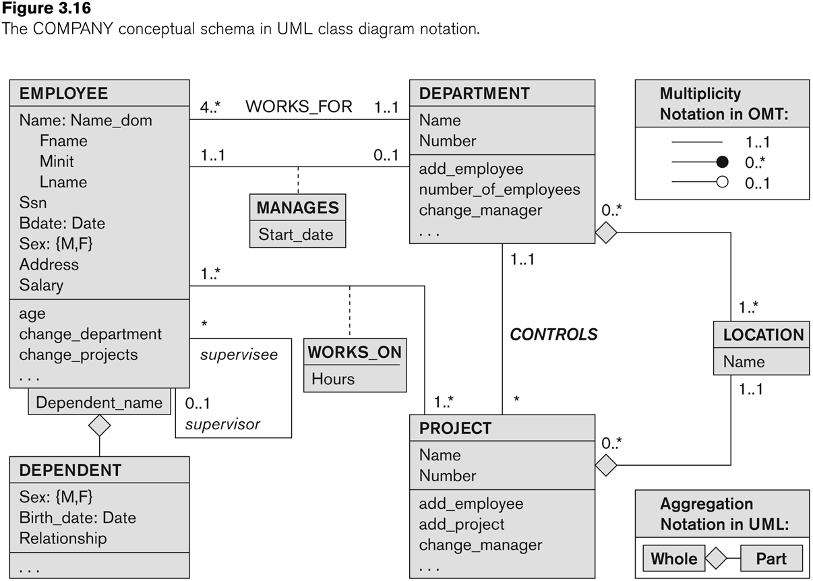
UML class diagram for COMPANY database schema

Slide 61
Relationships of Higher Degree
Relationship types of degree 2 are called binary
Relationship types of degree 3 are called ternary and of degree n are called n-ary
In general, an n-ary relationship is not equivalent to n binary relationships
Constraints are harder to specify for higher-degree relationships (n > 2) than for binary relationships

Slide 62
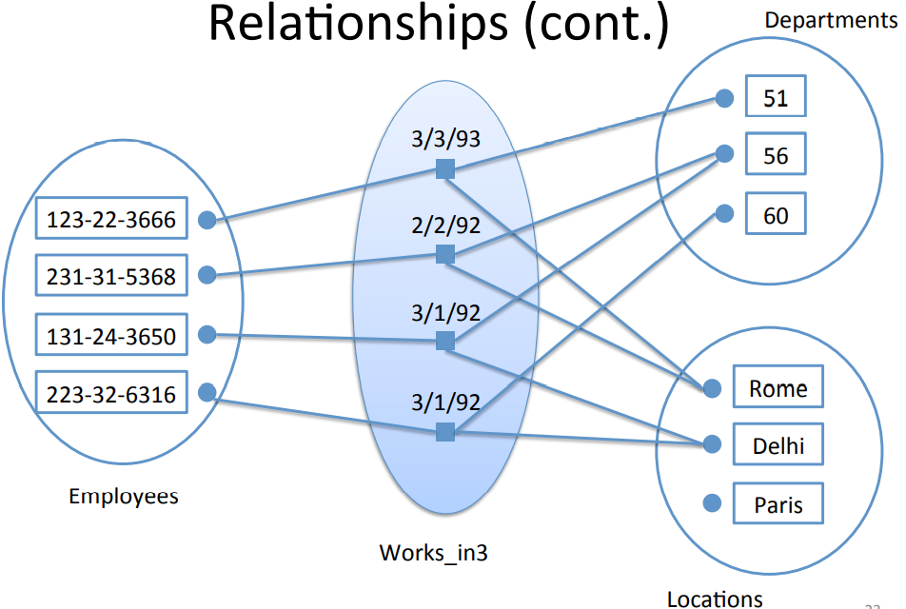
Relationships of Higher Degree

Slide 63
Discussion of n-ary relationships (n > 2)
In general, 3 binary relationships can represent different information than a single ternary relationship.
If needed, the binary and n-ary relationships can all be included in the schema design (where all relationships convey different meanings)
In some cases, a ternary relationship can be represented as a weak entity if the data model allows a weak entity type to have multiple identifying relationships (and hence multiple owner entity types)

Slide 64
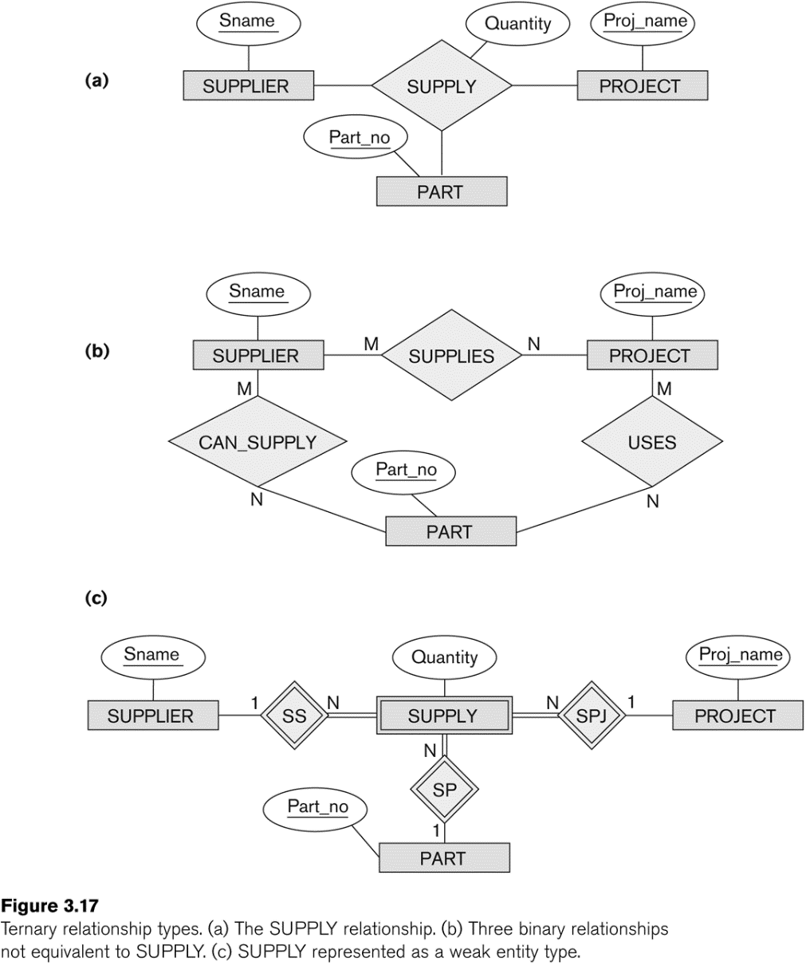
Ternary vs. Binary relationship
(a) The SUPPLY relationship.
(b) Three binary relationships not equivalent to SUUPLY.
(c) SUPPLY represented as weak entity type

Slide 65
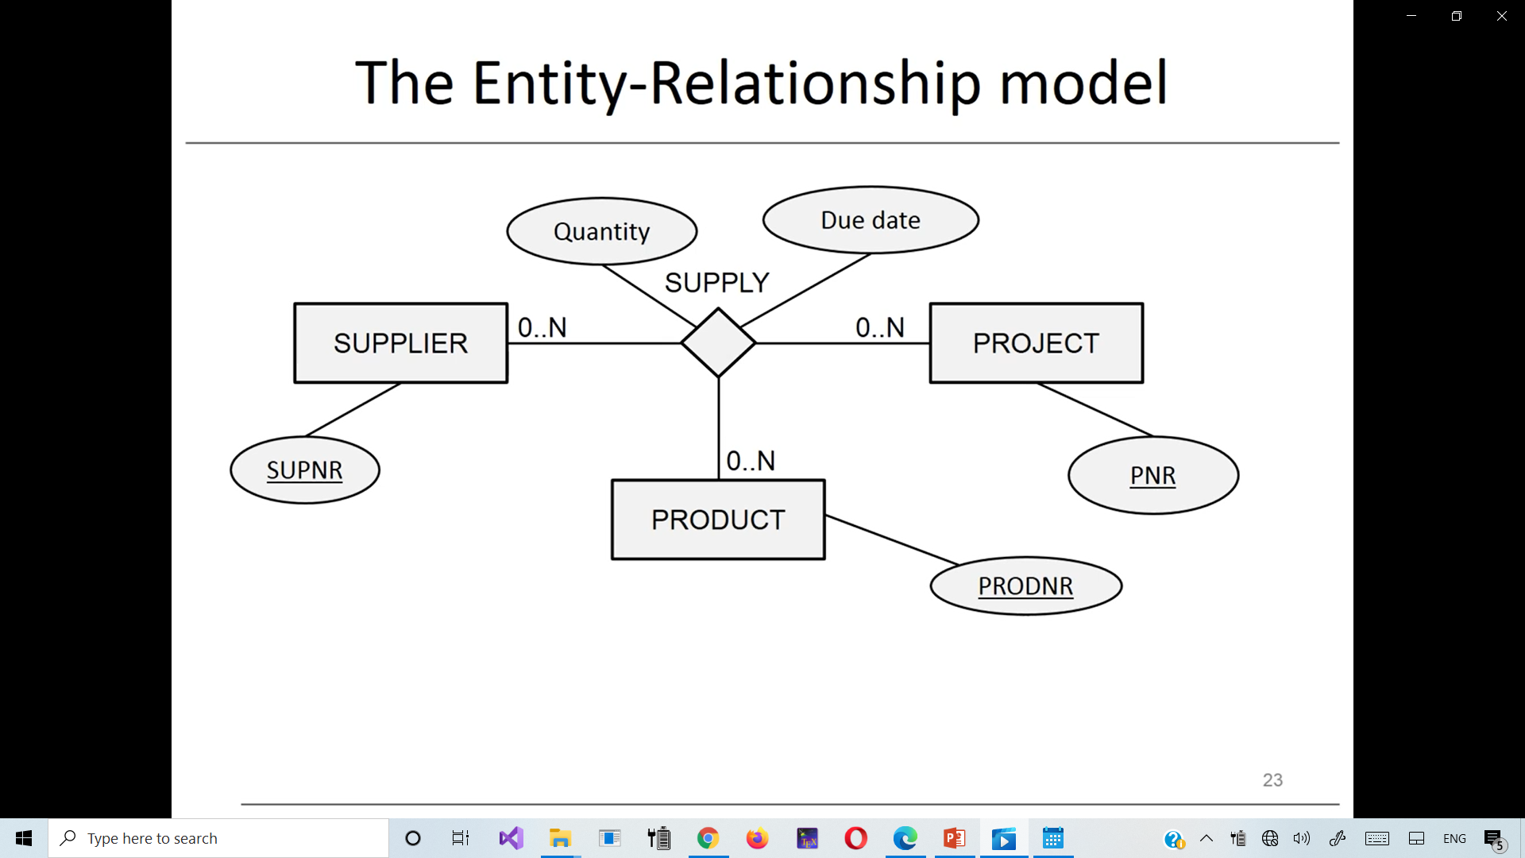
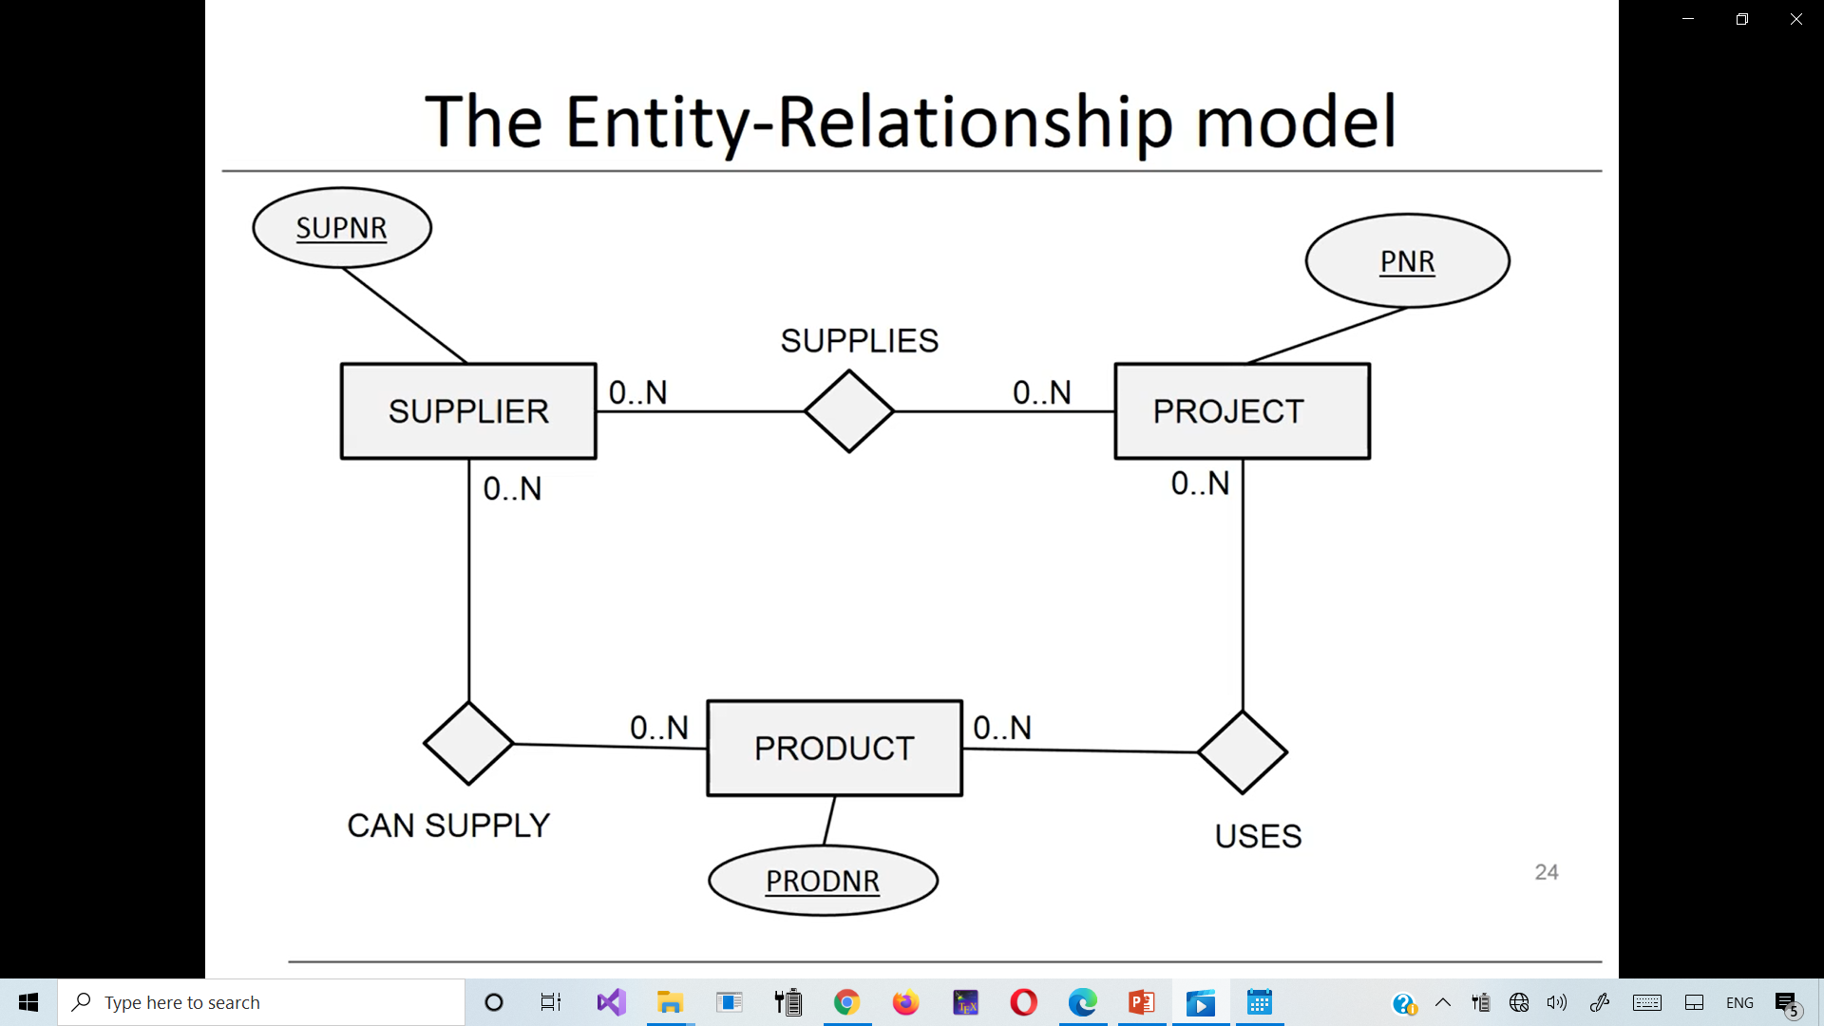
Example of a ternary relationship
(a) The SUPPLY relationship.
(b) Three binary
relationships

Slide 66
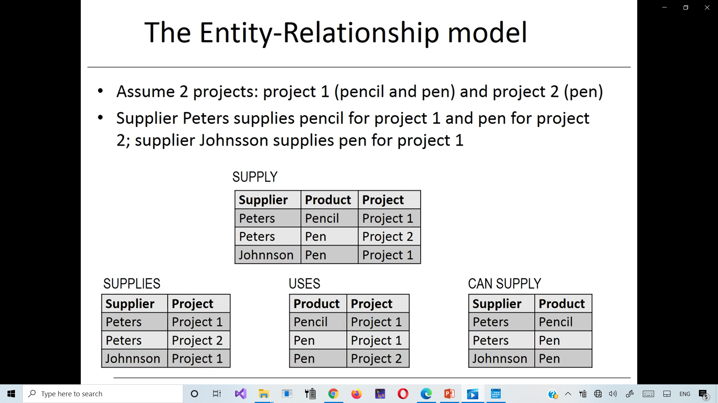
Ternary relationship vs. 3-Binary relationships
(a) The SUPPLY ternary relationship.
SUPPLY
are (a) and (b) equal?
Why?
(b) Three binary relationships.

Slide 67
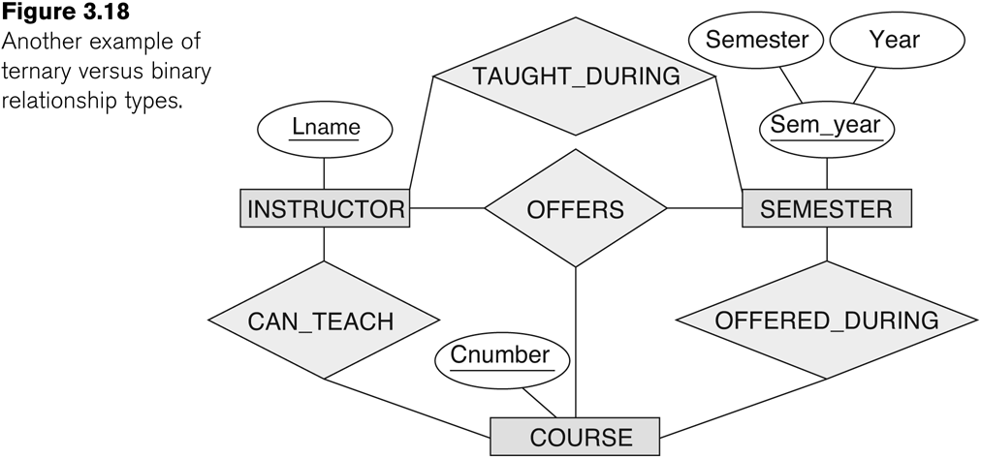
Discussion of n-ary relationships (n > 2)
If a particular binary relationship can be derived from a higher-degree relationship at all times, then it is redundant
For example, the TAUGHT_DURING binary relationship be derived from the ternary relationship OFFERS (based on the meaning of the relationships)
Another example of a ternary versus binary relationship types.

Slide 68
Displaying constraints on higher-degree relationships
The (min, max) constraints can be displayed on the edges – however, they do not fully describe the constraints
Displaying a 1, M, or N indicates additional constraints
An M or N indicates no constraint
A 1 indicates that an entity can participate in at most one relationship instance that has a particular combination of the other participating entities
In general, both (min, max) and 1, M, or N are needed to describe fully the constraints
Overall, the constraint specification is difficult and possibly ambiguous when we consider relationships of a degree higher than two.

Slide 69
Another Example: A UNIVERSITY Database
To keep track of the enrollments in classes and student grades, another database is to be designed.
It keeps track of the COLLEGEs, DEPARTMENTs within each college, the COURSEs offered by departments, and SECTIONs of courses, INSTRUCTORs who teach the sections etc.
These entity types and the relationships among these entity types are shown on the next slide.

Slide 70
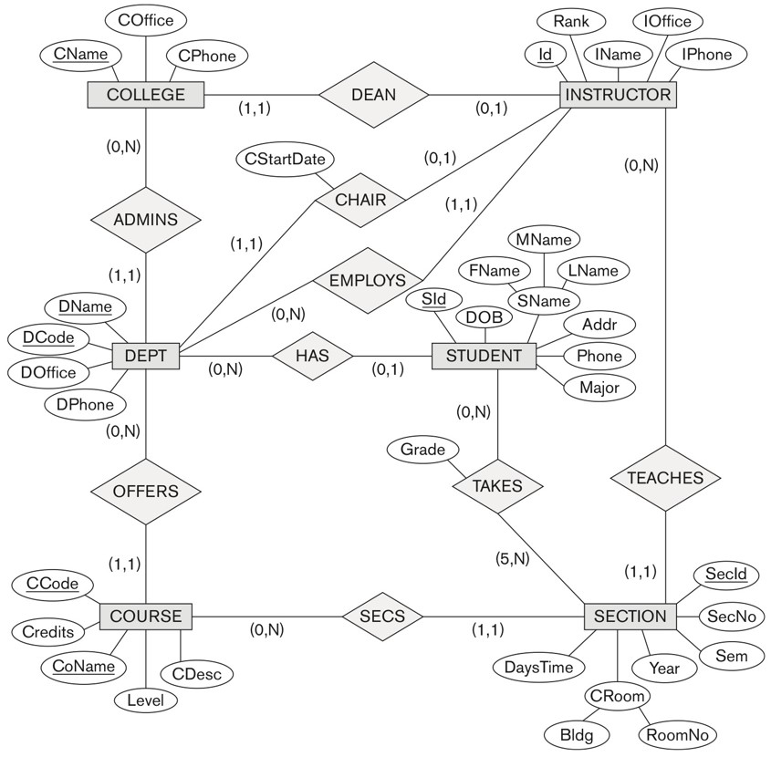

UNIVERSITY database conceptual schema
Notes:
■The university is organized into colleges (COLLEGE), and each college has a unique name (CName), a main office (COffice) and phone (CPhone), and a particular faculty member who is dean of the college. Each college administers a number of academic departments (DEPT). Each department has a unique name (DName), a unique code number (DCode), a main office (DOffice) and phone (DPhone), and a particular faculty member who chairs the department. We keep track of the start date (CStartDate) when that faculty member began chairing the department.
■ A department offers a number of courses (COURSE), each of which has a unique course name (CoName), a unique code number (CCode), a course level (Level: this can be coded as 1 for freshman level, 2 for sophomore, 3 for junior, 4 for senior, 5 for MS level, and 6 for PhD level), a course credit hours (Credits), and a course description (CDesc). The database also keeps track of instructors (INSTRUCTOR); and each instructor has a unique identifier (Id), name (IName), office (IOffice), phone (IPhone), and rank (Rank); in addition, each instructor works for one primary academic department.
■ The database will keep student data (STUDENT) and stores each student’s name (SName, composed of first name (FName), middle name (MName), last name (LName)), student id (Sid, unique for every student), address (Addr), phone (Phone), major code (Major), and date of birth (DoB). A student is assigned to one primary academic department. It is required to keep track of the student’s grades in each section the student has completed.
■ Courses are offered as sections (SECTION). Each section is related to a single course and a single instructor and has a unique section identifier (SecId). A section also has a section number (SecNo: this is coded as 1, 2, 3, . . . for multiple sections offered during the same semester/year), semester (Sem), year (Year), classroom (CRoom: this is coded as a combination of building code (Bldg) and room number (RoomNo) within the building), and days/times (DaysTime: for example, ‘MWF 9am-9.50am’ or ‘TR 3.30pm-5.20pm’— restricted to only allowed days/time values). (Note: The database will keep track of all the sections offered for the past several years, in addition to the current offerings. The SecId is unique for all sections, not just the sections for a particular semester.) The database keeps track of the students in each section, and the grade is recorded when available (this is a many-to-many relationship between students and sections). A section must have at least five students.

Slide 71
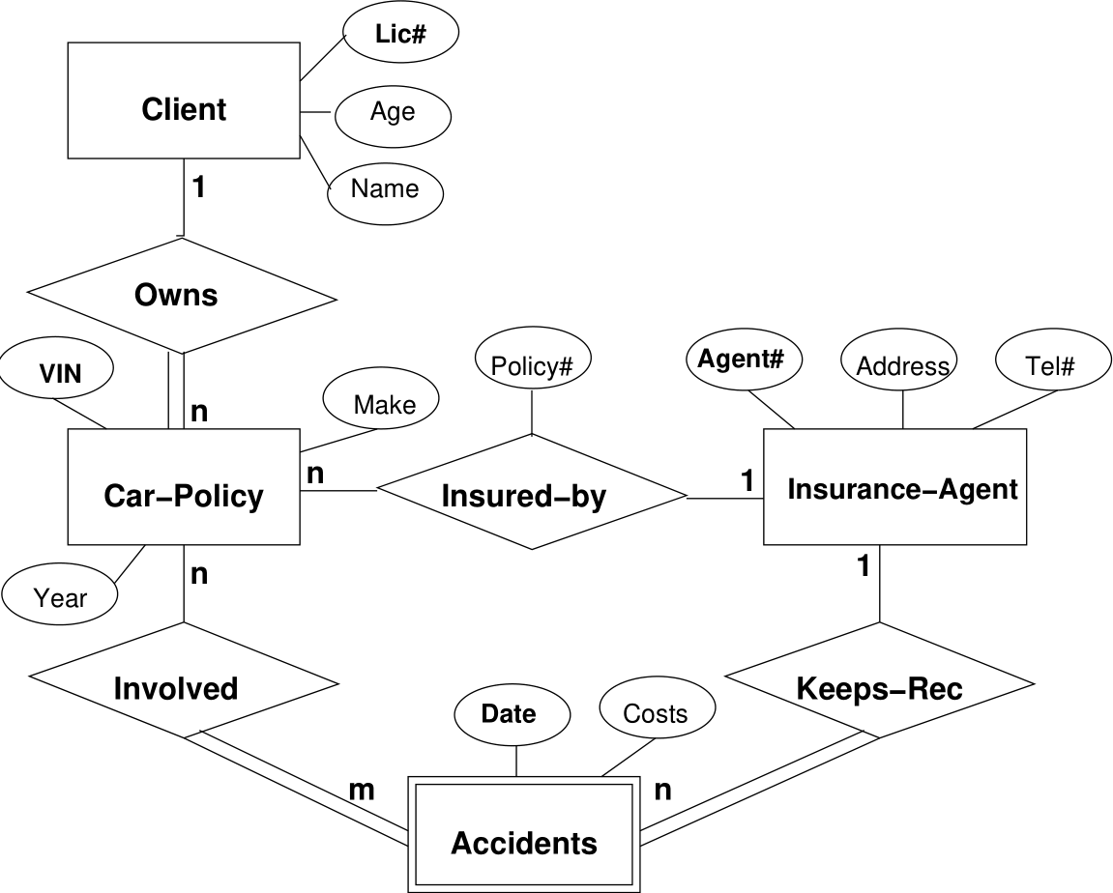
Another example

Slide 72
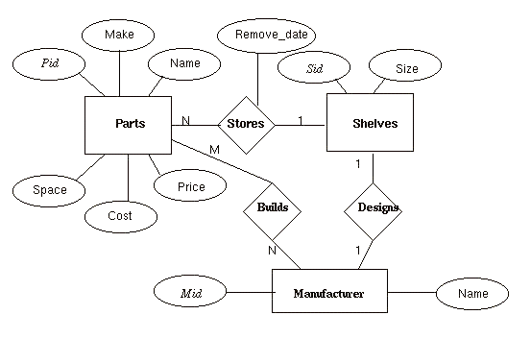
Another example

Slide 73
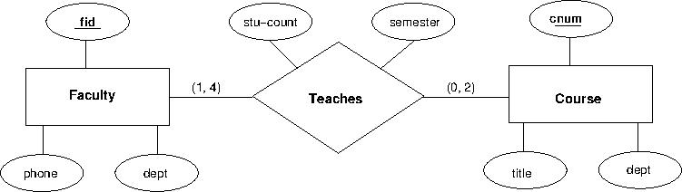
Another example

Slide 74
Review Questions
Define the following terms: entity, attribute, attribute value, relationship instance, composite attribute, multivalued attribute, derived attribute, complex attribute, key attribute, value set (domain), entity type and an entity set
What is a relationship type? Explain the differences among a relationship instance, a relationship type, and a relationship set.
What is a participation role? When is it necessary to use role names in the description of relationship types?
Describe the two alternatives for specifying structural constraints on relationship types.

Slide 75
Review Questions
What is meant by a recursive relationship type? Give some examples of recursive relationship types.
When is the concept of a weak entity used in data modeling? Define the terms owner entity type, weak entity type, identifying relationship type, and partial key.
Can an identifying relationship of a weak entity type be of a degree greater than two? Give examples to illustrate your answer.

Slide 76
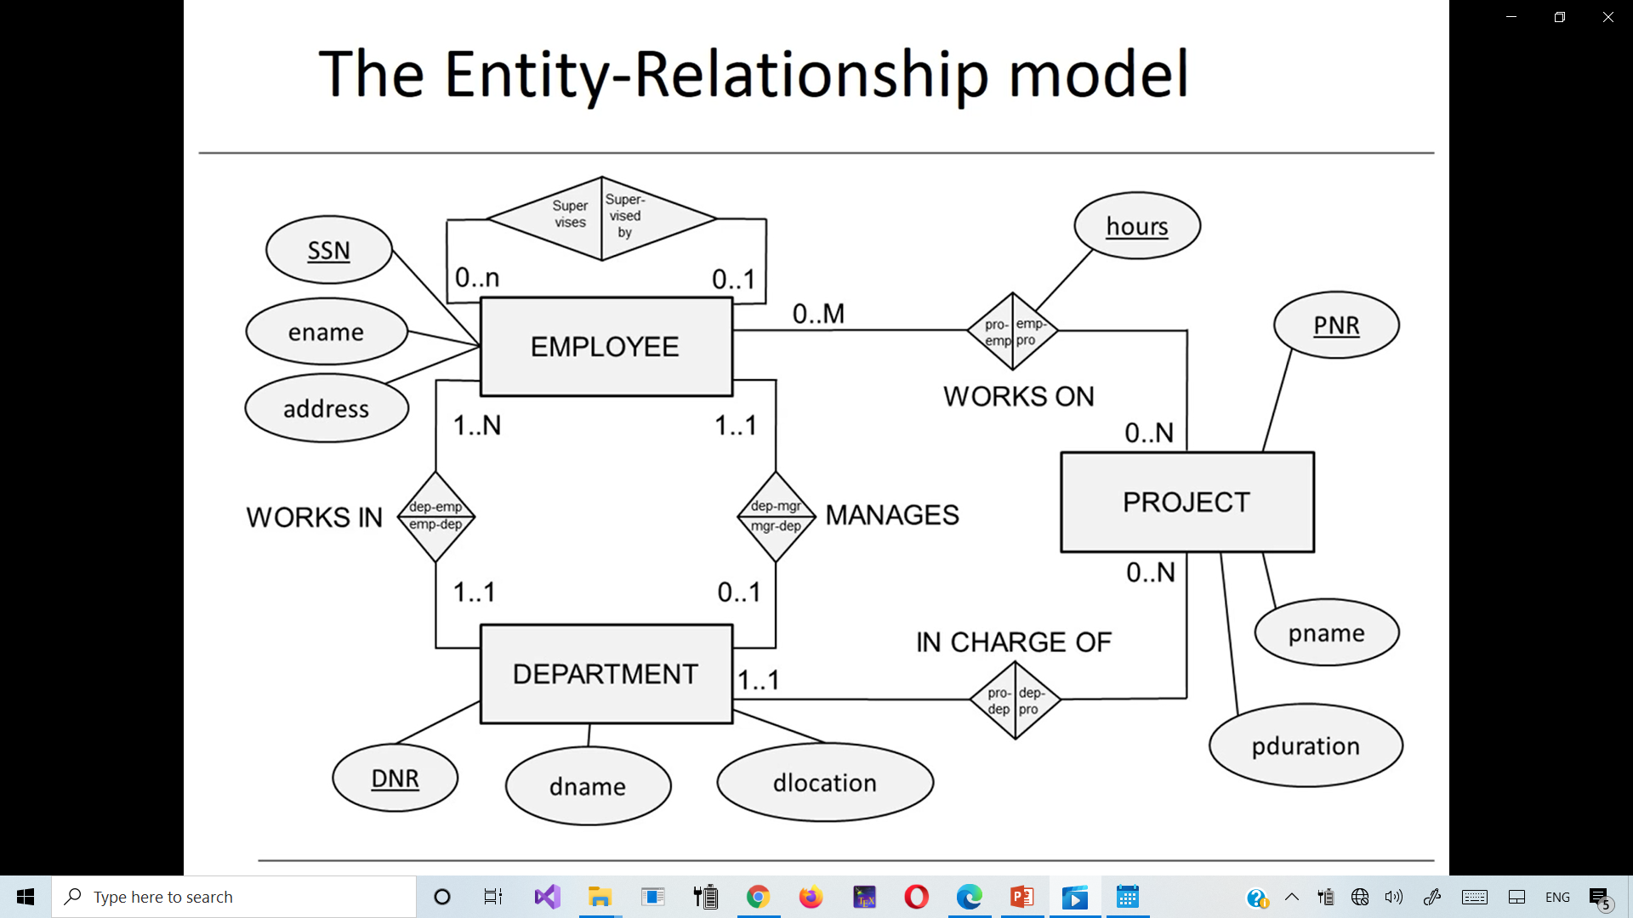
Exercise: Read(describe) a relationship

Slide 77
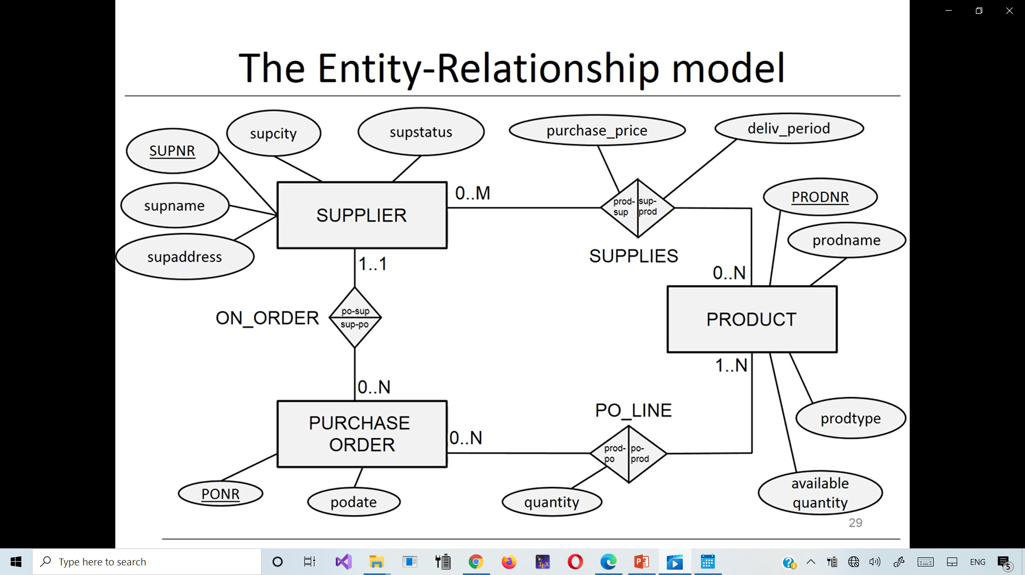
Exercise: Read(describe) a relationship

Slide 78
Limitations ER Relationship Model(1)
ER presents a temporary snapshot of a database.
Temporal aspects cannot be modeled
Examples
Project needs to be assigned to department after 1 month.
Employee cannot return to department of which he previously was a manager.
Employees need to be assigned to departments after 6 months.
Purchase order must be assigned to supplier after 2 weeks.

Slide 79
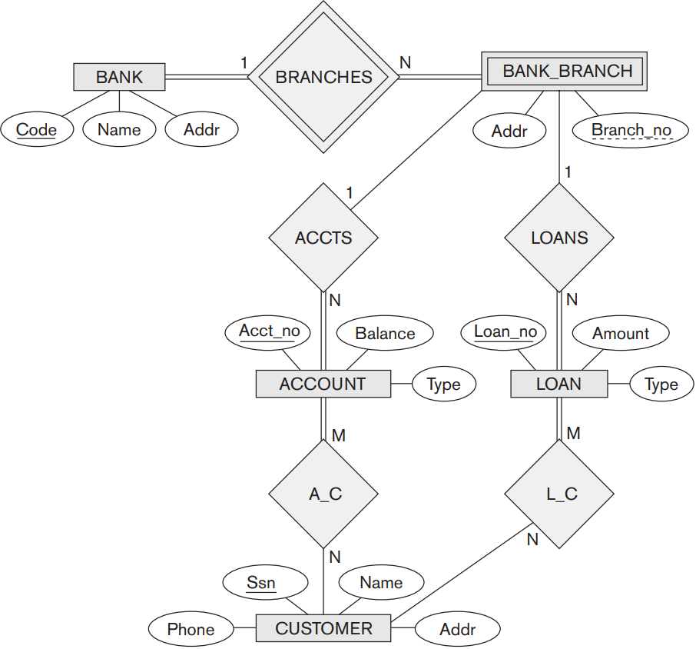
Exercise
a. List the strong (non-weak) entity types in the ER diagram.
b. Is there a weak entity type? If so, give its name, partial key, and identifying relationship.
c. What constraints do the partial key and the identifying relationship of the weak entity type specify in this diagram?

Slide 80
Exercise
c. What constraints do the partial key and the identifying relationship of the weak entity type specify in this diagram?
d. List the names of all relationship types, and specify the (min, max) constraint on each participation of an entity type in a relationship type. Justify your choices.

Slide 81
Exercise
e. List concisely the user requirements that led to this ER schema design.
f. Suppose that every customer must have at least one account but is restricted to at most two loans at a time, and that a bank branch cannot have more than 1,000 loans. How does this show up on the (min, max) constraints?

Slide 82
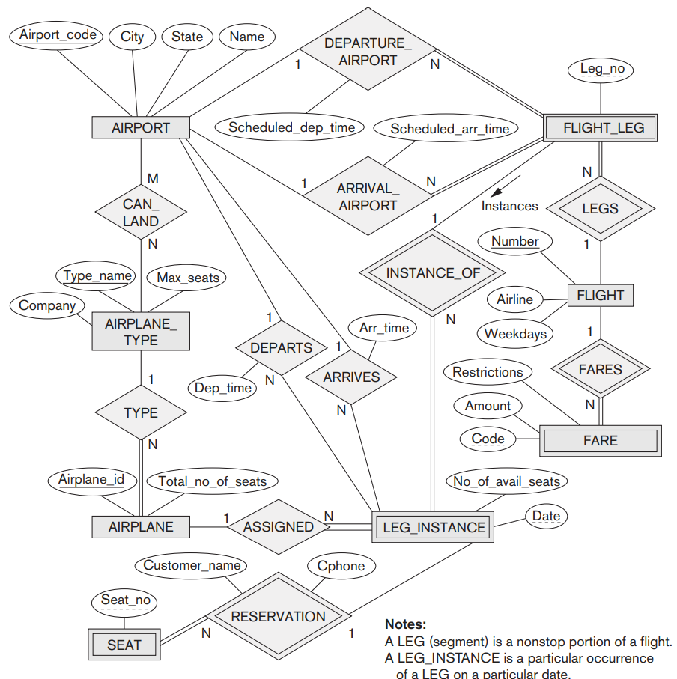
Exercise
Extract from the ER diagram the requirements and constraints that produced this schema. Try to be as precise as possible in your requirements and constraints specification.

Slide 83
Summary
ER Model Concepts: Entities, attributes, relationships
Constraints in the ER model
Using ER in step-by-step mode conceptual schema design for the COMPANY database
ER Diagrams - Notation
Alternative Notations – UML class diagrams, others
Binary Relationship types and those of higher degree.

Slide 84
Extended Entity-Relationship (EER) Model
EER stands for Enhanced ER or Extended ER
The entity relationship model in its original form did not support the specialization and generalization abstractions
Next slides illustrate how the ER model can be extended with
Type-subtype and set-subset relationships
Specialization/Generalization Hierarchies
Notation to display them in EER diagrams

Slide 85
Outline
EER Model Concepts
Includes all modeling concepts of basic ER
Additional concepts:
subclasses/superclasses
specialization/generalization
categories (UNION types)
attribute and relationship inheritance
Constraints on Specialization/Generalization
The additional EER concepts used to model applications more completely and more accurately
EER includes some object-oriented concepts, such as inheritance
Knowledge Representation and Ontology Concepts

Slide 86
Subclasses and Superclasses (1)
An entity type may have additional meaningful subgroupings of its entities
Example: EMPLOYEE may be further grouped into:
SECRETARY, ENGINEER, TECHNICIAN, …
Based on the EMPLOYEE’s Job
MANAGER
EMPLOYEEs who are managers (the role they play)
SALARIED_EMPLOYEE, HOURLY_EMPLOYEE
Based on the EMPLOYEE’s method of pay
EER diagrams extend ER diagrams to represent these additional subgroupings, called subclasses or subtypes

Slide 87
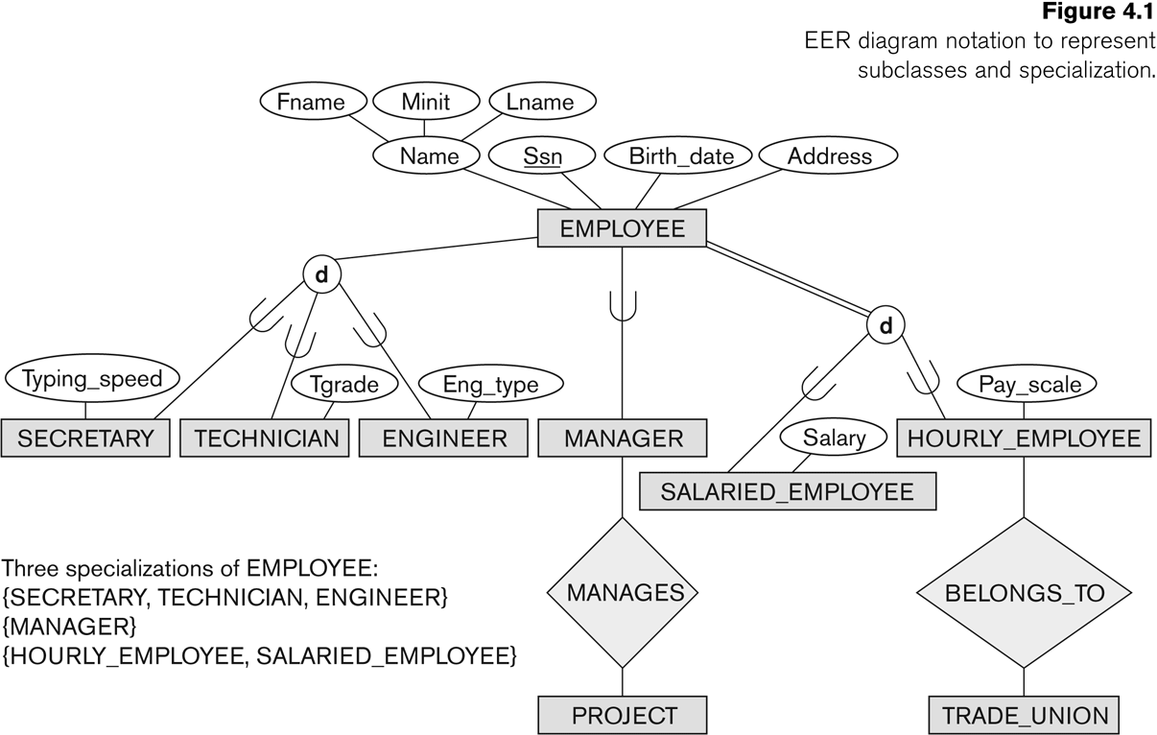
Subclasses and Superclasses

Slide 88
Subclasses and Superclasses (2)
Each of these subgroupings is a subset of EMPLOYEE entities
Each is called a subclass of EMPLOYEE
EMPLOYEE is the superclass for each of these subclasses
These are called superclass/subclass relationships:
EMPLOYEE/SECRETARY
EMPLOYEE/TECHNICIAN
EMPLOYEE/MANAGER
…

Slide 89
Subclasses and Superclasses (3)
These are also called IS-A relationships
SECRETARY IS-A EMPLOYEE, TECHNICIAN IS-A EMPLOYEE, ….
Note: An entity that is member of a subclass represents the same real-world entity as some member of the superclass:
The subclass member is the same entity in a distinct specific role
An entity cannot exist in the database merely by being a member of a subclass; it must also be a member of the superclass
A member of the superclass can be optionally included as a member of any number of its subclasses

Slide 90
Subclasses and Superclasses (4)
Examples:
A salaried employee who is also an engineer belongs to the two subclasses:
ENGINEER, and
SALARIED_EMPLOYEE
A salaried employee who is also an engineering manager belongs to the three subclasses:
MANAGER,
ENGINEER, and
SALARIED_EMPLOYEE
It is not necessary that every entity in a superclass be a member of some subclass

Slide 91
Attribute Inheritance in Superclass / Subclass Relationships
An entity that is member of a subclass inherits
All attributes of the entity as a member of the superclass
All relationships of the entity as a member of the superclass
Example:
In the previous slide, SECRETARY (as well as TECHNICIAN and ENGINEER) inherit the attributes Name, SSN, …, from EMPLOYEE
Every SECRETARY entity will have values for the inherited attributes

Slide 92
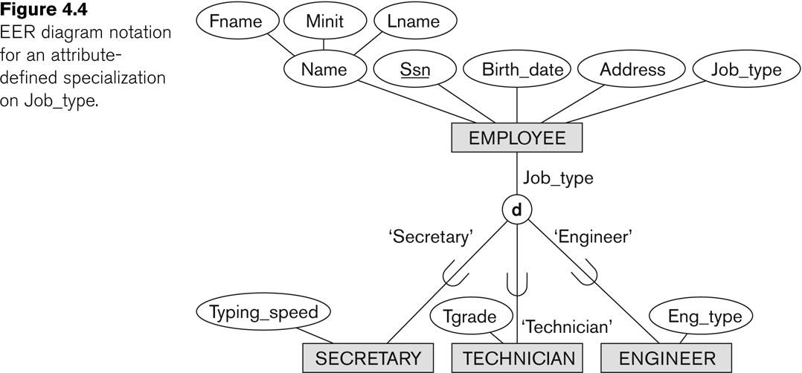
Representing Specialization in EER Diagrams

Slide 93
Specialization (1)
Specialization is the process of defining a set of subclasses of a superclass
The set of subclasses is based upon some distinguishing characteristics of the entities in the superclass
Example: {SECRETARY, ENGINEER, TECHNICIAN} is a specialization of EMPLOYEE based upon job type.
Example: MANAGER is a specialization of EMPLOYEE based on the role the employee plays
May have several specializations of the same superclass

Slide 94
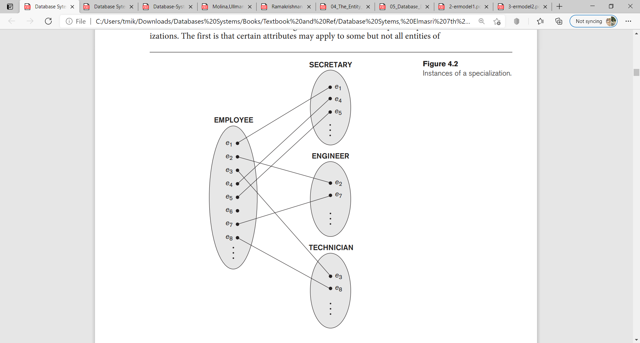
Specialization (2)
Example:
SECRETARY,
ENGINEER and
TECHNICIAN
is a specialization of EMPLOYEE based upon job type.

Slide 95
Specialization (3)
Example: Another specialization of EMPLOYEE based on method of pay is {SALARIED_EMPLOYEE, HOURLY_EMPLOYEE}.
Superclass/subclass relationships and specialization can be diagrammatically represented in EER diagrams
Attributes of a subclass are called specific or local attributes.
For example, the attribute TypingSpeed of SECRETARY
The subclass can also participate in specific relationship types.
For example, a relationship BELONGS_TO of HOURLY_EMPLOYEE

Slide 96
Specialization (4)

Slide 97
Generalization
Generalization is the reverse of the specialization process
Several classes with common features are generalized into a superclass;
original classes become its subclasses
Example: CAR, TRUCK generalized into VEHICLE;
both CAR, TRUCK become subclasses of the superclass VEHICLE.
We can view {CAR, TRUCK} as a specialization of VEHICLE
Alternatively, we can view VEHICLE as a generalization of CAR and TRUCK

Slide 98
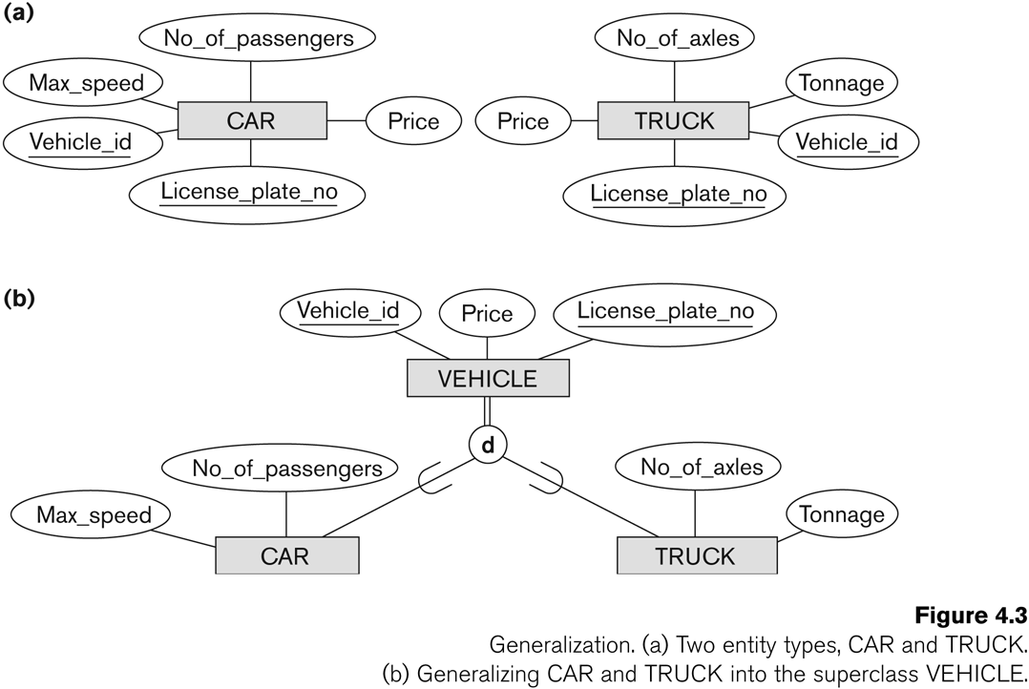
Generalization (2)

Slide 99
Generalization and Specialization (1)
Diagrammatic notations are sometimes used to distinguish between generalization and specialization
Arrow pointing to the generalized superclass represents a generalization
Arrows pointing to the specialized subclasses represent a specialization
We do not use this notation because it is often subjective as to which process is more appropriate for a particular situation
We advocate not drawing any arrows

Slide 100
Generalization and Specialization (2)
Data Modeling with Specialization and Generalization
A superclass or subclass represents a collection (or set or grouping) of entities
It also represents a particular type of entity
Shown in rectangles in EER diagrams (as are entity types)
We can call all entity types (and their corresponding collections) classes, whether they are entity types, superclasses, or subclasses

Slide 101
Types of Specialization
Predicate-defined ( or condition-defined) : based on some predicate. E.g., based on value of an attribute, say, Job-type, or Age.
Attribute-defined: shows the name of the attribute next to the line drawn from the superclass toward the subclasses
User-defined: membership is defined by the user on an entity by entity basis

Slide 102
Constraints on Specialization and Generalization (1)
If we can determine exactly those entities that will become members of each subclass by a condition, the subclasses are called predicate-defined (or condition-defined) subclasses
Condition is a constraint that determines subclass members
Display a predicate-defined subclass by writing the predicate condition next to the line attaching the subclass to its superclass

Slide 103
Constraints on Specialization and Generalization (2)
If all subclasses in a specialization have membership condition on same attribute of the superclass, specialization is called an attribute-defined specialization
Attribute is called the defining attribute of the specialization
Example: JobType is the defining attribute of the specialization {SECRETARY, TECHNICIAN, ENGINEER} of EMPLOYEE
If no condition determines membership, the subclass is called user-defined
Membership in a subclass is determined by the database users by applying an operation to add an entity to the subclass
Membership in the subclass is specified individually for each entity in the superclass by the user

Slide 104
Displaying an attribute-defined specialization in EER diagrams
EER diagram notation for an attribute-defined specialization on job_type

Slide 105
Constraints on Specialization and Generalization (3)
Two basic constraints can apply to a specialization/generalization:
Disjointness Constraint:
Completeness Constraint:

Slide 106
Constraints on Specialization and Generalization (4)
Disjointness Constraint:
Specifies that the subclasses of the specialization must be disjoint:
an entity can be a member of at most one of the subclasses of the specialization
Specified by d in EER diagram
If not disjoint, specialization is overlapping:
that is the same entity may be a member of more than one subclass of the specialization
Specified by o in EER diagram

Slide 107
Constraints on Specialization and Generalization (5)
Completeness (Exhaustiveness) Constraint:
Total specifies that every entity in the superclass must be a member of some subclass in the specialization/generalization
Shown in EER diagrams by a double line
Partial allows an entity not to belong to any of the subclasses
Shown in EER diagrams by a single line

Slide 108
Constraints on Specialization and Generalization (6)
Hence, we have four types of specialization/generalization:
Disjoint, total
Disjoint, partial
Overlapping, total
Overlapping, partial
Question: Generalization is Total (True | False)
Answer: Generalization usually is total because the superclass is derived from the subclasses.

Slide 109
Example of disjoint partial Specialization
EER diagram notation for an attribute-defined specialization on job_type

Slide 110
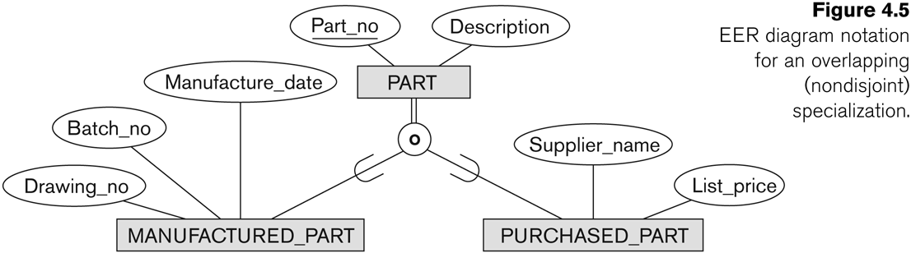
Example of overlapping total Specialization
EER diagram notation for an overlapping (non disjoint) specialization

Slide 111
Specialization/Generalization Hierarchies, Lattices & Shared Subclasses (1)
A subclass may itself have further subclasses specified on it
forms a hierarchy or a lattice
Hierarchy has a constraint that every subclass has only one superclass (called single inheritance); this is basically a tree structure
In a lattice, a subclass can be subclass of more than one superclass (called multiple inheritance)

Slide 112
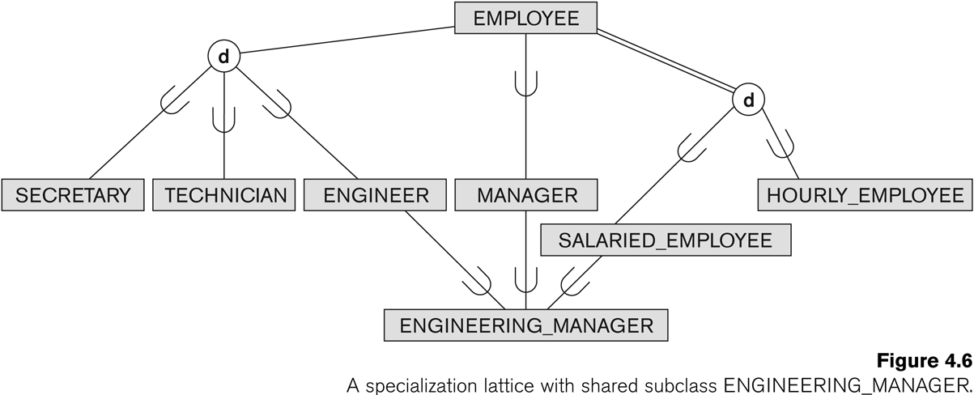
Shared Subclass “Engineering_Manager”
A specialization lattice with shared subclass ENGINEERING_MANAGER

Slide 113
Specialization/Generalization Hierarchies, Lattices & Shared Subclasses (2)
In a lattice or hierarchy, a subclass inherits attributes not only of its direct superclass, but also of all its predecessor superclasses
A subclass with more than one superclass is called a shared subclass (multiple inheritance)
depending on how they were derived, we can have:
specialization hierarchies or lattices, or
generalization hierarchies or lattices,
Notes:
We just use specialization (to stand for the end result of either specialization or generalization)

Slide 114
Refining
Conceptual Schemas

Slide 115
Utilizing Specialization and Generalization in Refining Conceptual Schemas
In specialization, start with an entity type and then define subclasses of the entity type by successive specialization
called a top down conceptual refinement process
In generalization, start with many entity types and generalize those that have common properties
Called a bottom up conceptual synthesis process
In practice, a combination of both processes is usually employed

Slide 116
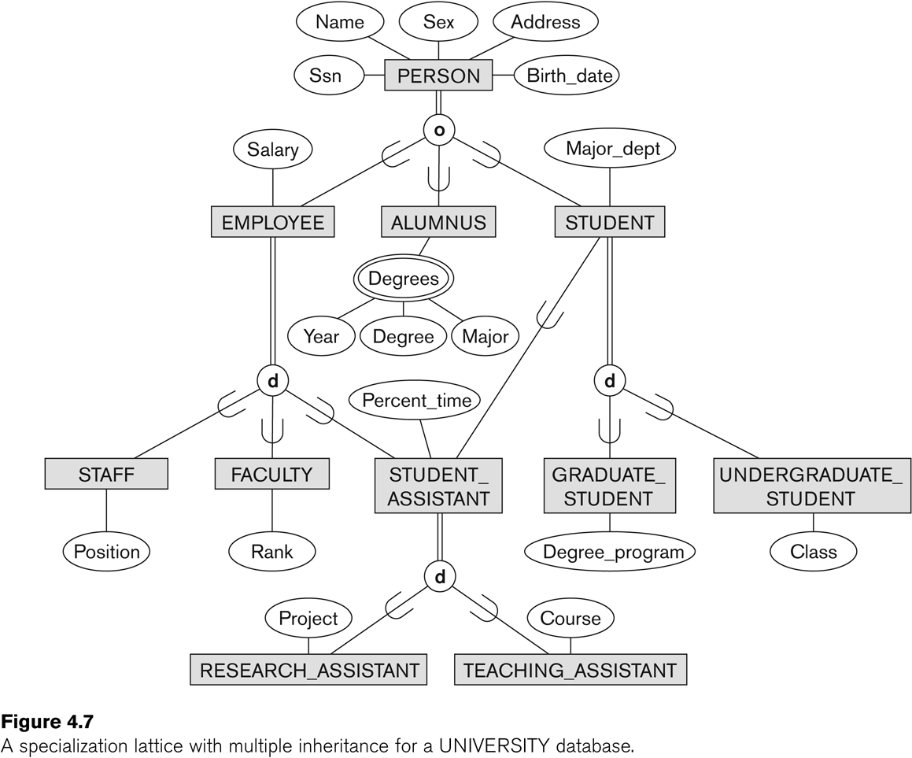
Top Down conceptual refinement process Example - a specialization lattice with multiple inheritance for a UNIVERSITY database.
Top Down conceptual refinement process
When designing the specialization lattice ,we may first specify an entity type PERSON for a university database.

Slide 117
Top Down conceptual refinement process Example - a specialization lattice with multiple inheritance for a UNIVERSITY database.
Then we discover that three types of persons will be represented in the database: university employees, alumni, and students and we create the specialization {EMPLOYEE, ALUMNUS, STUDENT}.
Notes:
The overlapping constraint is chosen because a person may belong to more than one of the subclasses.

Slide 118
Top Down conceptual refinement process Example - a specialization lattice with multiple inheritance for a UNIVERSITY database.
We specialize EMPLOYEE further into {STAFF, FACULTY, STUDENT_ASSISTANT}, and specialize STUDENT into {GRADUATE_STUDENT, UNDERGRADUATE_STUDENT}.

Slide 119
Top Down conceptual refinement process Example - a specialization lattice with multiple inheritance for a UNIVERSITY database.
Notes:
So far, we have a hierarchy; then we realize that STUDENT_ASSISTANT is a shared subclass, since it is also a subclass of STUDENT, leading to the lattice.

Slide 120

Top Down conceptual refinement process
Bottom-up conceptual synthesis

Slide 121
Bottom-up conceptual synthesis
Notes:
For example, the database designers may first discover entity types such as
STAFF, FACULTY, ALUMNUS, GRADUATE_STUDENT, UNDERGRADUATE_STUDENT, RESEARCH_ASSISTANT, TEACHING_ASSISTANT, and so on;
then they generalize {GRADUATE_STUDENT, UNDERGRADUATE_STUDENT} into STUDENT;
then {RESEARCH_ASSISTANT, TEACHING_ASSISTANT} into STUDENT_ASSISTANT;
then {STAFF, FACULTY, STUDENT_ASSISTANT} into EMPLOYEE; and
finally {EMPLOYEE, ALUMNUS, STUDENT} into PERSON.

Slide 122
Bottom-up Conceptual Synthesis
For example, the database designers may first discover entity types such as
STAFF, FACULTY, ALUMNUS, GRADUATE_STUDENT, UNDERGRADUATE_STUDENT, RESEARCH_ASSISTANT, TEACHING_ASSISTANT, and so on;
then they generalize {GRADUATE_STUDENT, UNDERGRADUATE_STUDENT} into STUDENT;
then {RESEARCH_ASSISTANT, TEACHING_ASSISTANT} into STUDENT_ASSISTANT;
then {STAFF, FACULTY, STUDENT_ASSISTANT} into EMPLOYEE; and
finally {EMPLOYEE, ALUMNUS, STUDENT} into PERSON.

Slide 123
Categories (UNION TYPES) (1)
All of the superclass/subclass relationships we have seen thus far have a single superclass
A shared subclass is a subclass in:
more than one distinct superclass/subclass relationships
each relationships has a single superclass
shared subclass leads to multiple inheritance
In some cases, we need to model a single superclass/subclass relationship with more than one superclass
Superclasses can represent different entity types
Such a subclass is called a category or UNION TYPE

Slide 124
Categories (UNION TYPES) (2)
Example: In a database for vehicle registration, a vehicle owner can be a PERSON, a BANK (holding a lien on a vehicle) or a COMPANY.
A category (UNION type) called OWNER is created to represent a subset of the union of the three superclasses COMPANY, BANK, and PERSON
A category member must exist in at least one (typically just one) of its superclasses
Difference from shared subclass, which is a:
subset of the intersection of its superclasses
shared subclass member must exist in all of its superclasses

Slide 125
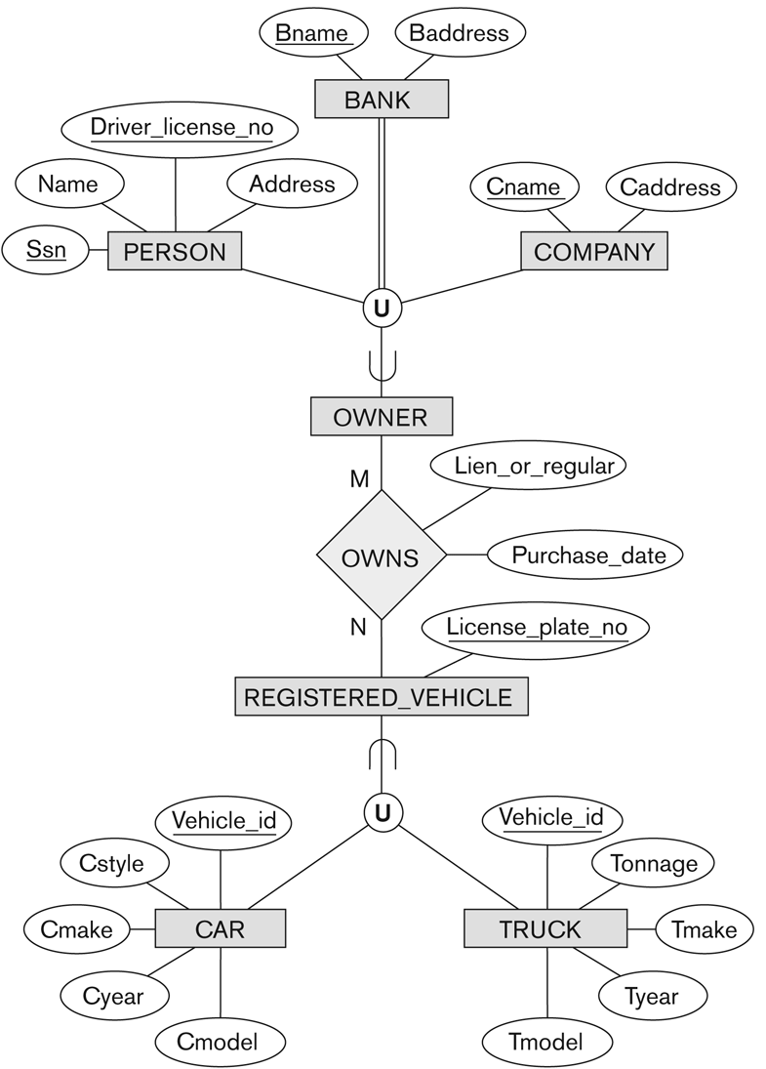
Two categories (UNION types): OWNER, REGISTERED_VEHICLE

Slide 126
Design Choices for Specialization/Generalization
It is not always easy to choose the most appropriate conceptual design for a database application.
Conceptual database design should be considered as an iterative refinement process until the most suitable design is reached.
The following guidelines (next slide) can help to guide the design process for EER concepts:

Slide 127
Design Choices for Specialization/Generalization(2)
Many specializations and subclasses can be defined to make the conceptual model accurate.
the drawback is that the design becomes quite cluttered.
If a subclass has few specific (local) attributes and no specific relationships, it can be merged into the superclass.
The specific attributes would hold NULL values for entities that are not members of the subclass.
A type attribute could specify whether an entity is a member of the subclass.
Notes:
. It is important to represent only those subclasses that are deemed necessary to avoid extreme cluttering of the conceptual schema.

Slide 128
Design Choices for Specialization/Generalization(3)
If all the subclasses of a specialization/generalization have few specific attributes and no specific relationships,
they can be merged into the superclass and replaced with one or more type attributes that specify the subclass or subclasses that each entity belongs.
Notes:
. It is important to represent only those subclasses that are deemed necessary to avoid extreme cluttering of the conceptual schema.

Slide 129
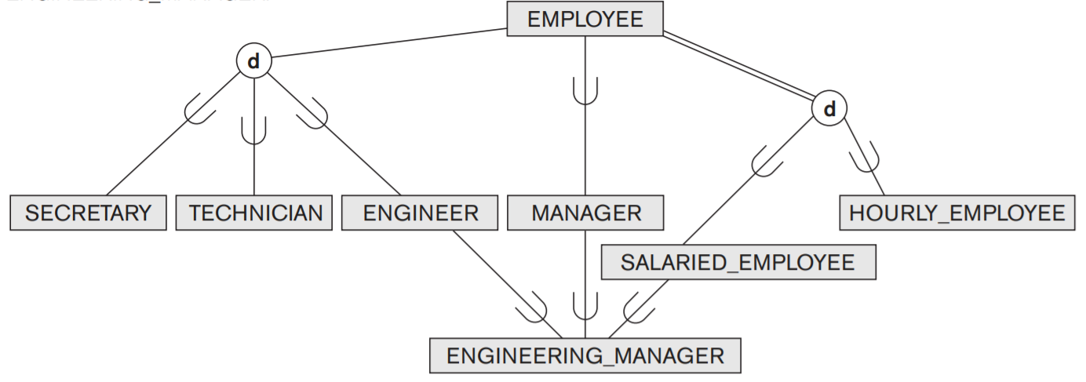
Design Choices for Specialization/Generalization(3)
No specific (local) attributes are shown. We could merge all the subclasses into the EMPLOYEE entity type and add the following attributes to EMPLOYEE:
An attribute Job_type whose value set {‘Secretary’, ‘Engineer’, ‘Technician’} .
An attribute Pay_method whose value set {‘Salaried’, ‘Hourly’} .
An attribute Is_a_manager whose value set {‘Yes’, ‘No’} .

Slide 130
Design Choices for Specialization/Generalization(4)
Union types and categories should generally be avoided unless the situation definitely warrants this type of construct, which does occur in some practical situations
If the requirements do not indicate any particular constraints, (disjoint/overlapping and total/partial) the default would generally be overlapping and partial, since this does not specify any restrictions on subclass membership.
Notes:
total/partial constraints on special-ization/generalization is driven by the rules in the miniworld being mod-eled. If the requirements do not indicate any particular constraints, the default would generally be overlapping and partial,

Slide 131
Formal Definitions of EER Model (1)
Class C:
A type of entity with a corresponding set of entities:
could be entity type, subclass, superclass, or category
Note: The definition of relationship type in ER/EER should have 'entity type' replaced with 'class‘ to allow relationships among classes in general
Subclass S is a class whose:
Type inherits all the attributes and relationship of a class C
Set of entities must always be a subset of the set of entities of the other class C
S ⊆ C
C is called the superclass of S
A superclass/subclass relationship exists between S and C
Notes:
We now summarize the EER model concepts and give formal definitions.

Slide 132
Formal Definitions of EER Model (2)
Specialization Z: Z = {S₁, S₂,…, S_{n}} is a set of subclasses with same superclass G; hence, G/S_{i} is a superclass relationship for i = 1, …., n.
G is called a generalization of the subclasses {S₁, S₂,…, S_{n}}
Z is total if we always have:
S₁ ∪ S₂ ∪ … ∪ S_{n} = G;
Otherwise, Z is partial.
Z is disjoint if we always have:
S_{i} ∩ S_{j} empty-set for i ≠ j;
Otherwise, Z is overlapping.

Slide 133
Formal Definitions of EER Model (3)
Subclass S of C is predicate defined if predicate (condition) p on attributes of C is used to specify membership in S;
that is, S = C[p], where C[p] is the set of entities in C that satisfy condition p
A subclass not defined by a predicate is called user-defined
Attribute-defined specialization: if a predicate A = C_{i} (where A is an attribute of G and C_{i} is a constant value from the domain of A) is used to specify membership in each subclass S_{i} in Z
Note: If ci ≠ cj for i ≠ j, and A is single-valued, then the attribute-defined specialization will be disjoint.

Slide 134
Formal Definitions of EER Model (4)
Category or UNION type T
A class that is a subset of the union of n defining superclasses D₁, D₂,…D_{n}, n > 1:
T ⊆ (D₁ ∪ D₂ ∪ … ∪ D_{n})
Can have a predicate p_{i} on the attributes of D_{i} to specify entities of D_{i} that are members of T.
If a predicate is specified on every D_{i}: T = (D₁[p₁] ∪ D₂[p₂] ∪…∪ D_{n}[p_{n}])

Slide 135
General Basis for Conceptual Modeling(1)
TYPES OF DATA ABSTRACTIONS
GENERALIZATION and SPECIALIZATION
AGGREGATION and ASSOCIATION (relationships)
CLASSIFICATION and INSTANTIATION
IDENTIFICATION
CONSTRAINTS
CARDINALITY (Min and Max)
COVERAGE (Total vs. Partial, and Exclusive (Disjoint) vs. Overlapping)

Slide 136
Aggregation and Association
Aggregation: building composite objects from their component objects.
we aggregate attribute values of an object to form the whole object.
We represent an aggregation relationship as an ordinary relationship.

Slide 137
Aggregation and Association
Aggregation
Involves the possibility of combining objects that are related by a particular relationship instance into a higher-level aggregate object(not supported by EER model ).
useful when the higher-level aggregate object is itself to be related to another object.
We call the relationship between the primitive objects and their aggregate object IS-A-PART-OF;
the inverse is called IS-A-COMPONENT-OF.
UML provides for all three types of aggregation.

Slide 138
Aggregation and Association
Association:
is used to associate objects from several independent classes.
it is somewhat similar to the second use of aggregation. It is represented in the EER model by relationship types, and in UML by associations.
This abstract relationship is called IS-ASSOCIATED-WITH.

Slide 139
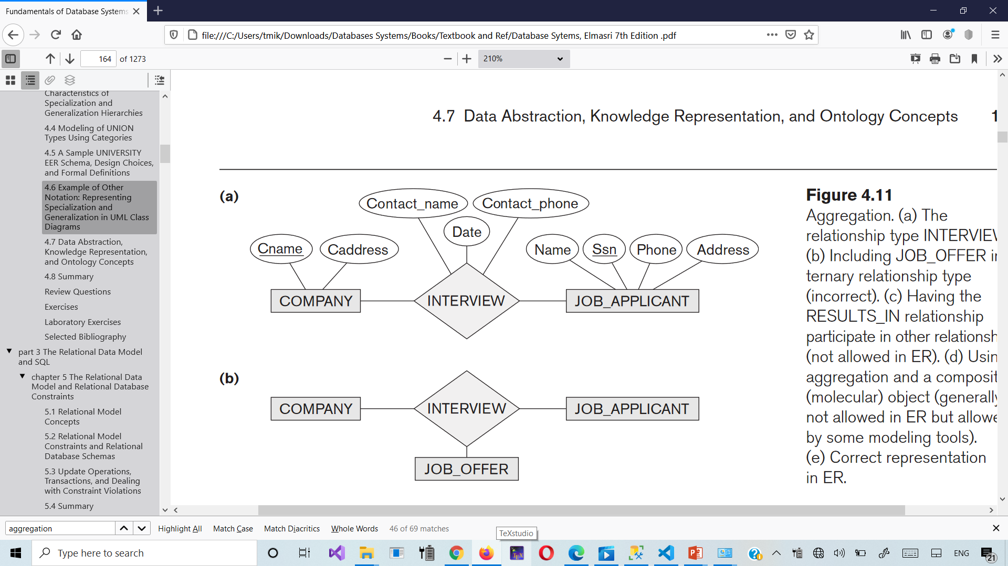
Aggregation
(a) The relationship type INTERVIEW.
(b) Including JOB_OFFER in a ternary relationship type (incorrect).

Slide 140
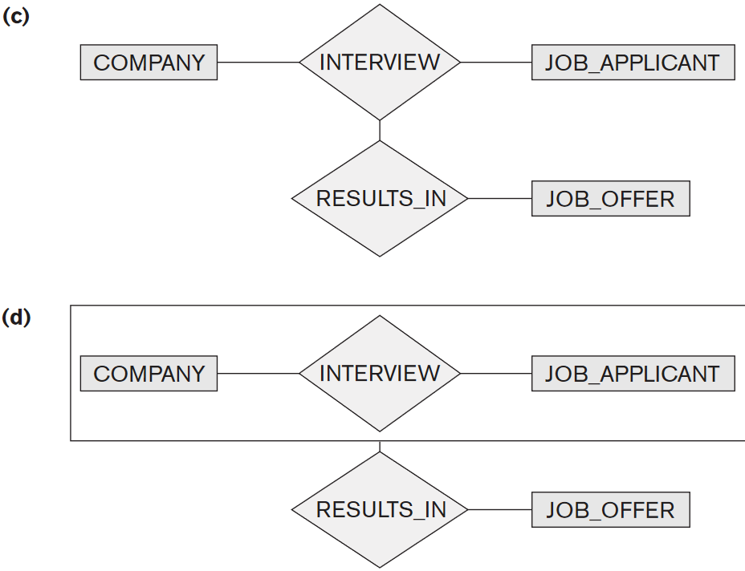
Aggregation
(c) Having the RESULTS_IN relationship participate in other relationships (not allowed in ER). (d) Using aggregation and a composite (molecular) object (generally not allowed in ER but allowed by some modeling tools).

Slide 141
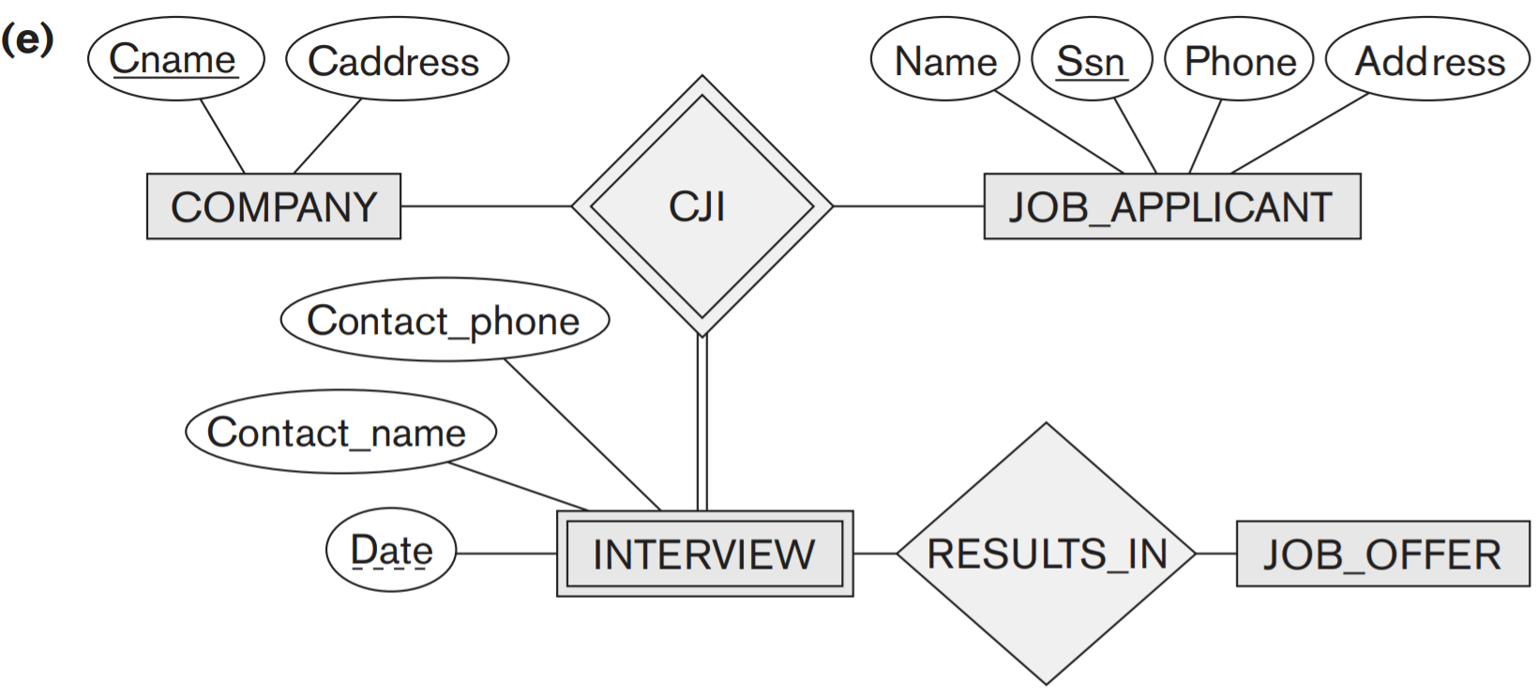
General Basis for Conceptual Modeling
(e) Correct representation in ER
We need to create a new weak entity type INTERVIEW and relate it to JOB_OFFER.
Hence, we can always represent these situations correctly in the ER model by creating additional entity types, although it may be conceptually more desirable to allow direct representation of aggregation

Slide 142
Conceptual Design Using the ER/EER Model
ER modeling can get tricky!
Design choices:
Entity or attribute?
Entity or relationship?
Relationships: Binary or ternary? Aggregation?
ER Model goals and limitations:
Lots of semantics can (and should) be captured.
Some constraints cannot be captured in ER.
We will refine things in our logical (relational) design

Slide 143
Principle 1: Avoiding Redundancy
Redundancy occurs when we say the same thing in two different ways
Redundancy wastes space and causes inconsistency
The two instances of the same fact may become inconsistent if we change one & forget to change the other

Slide 144
Principle 2: Entity vs. Attribute
“Address”:
attribute of Employees?
Entity of its own?
It depends! Semantics and usage.
Several addresses per employee?
must be an entity
Care about structure? (city, street, etc.)
must be an entity! (or at least multiple attributes)
Atomic attribute type

Slide 145
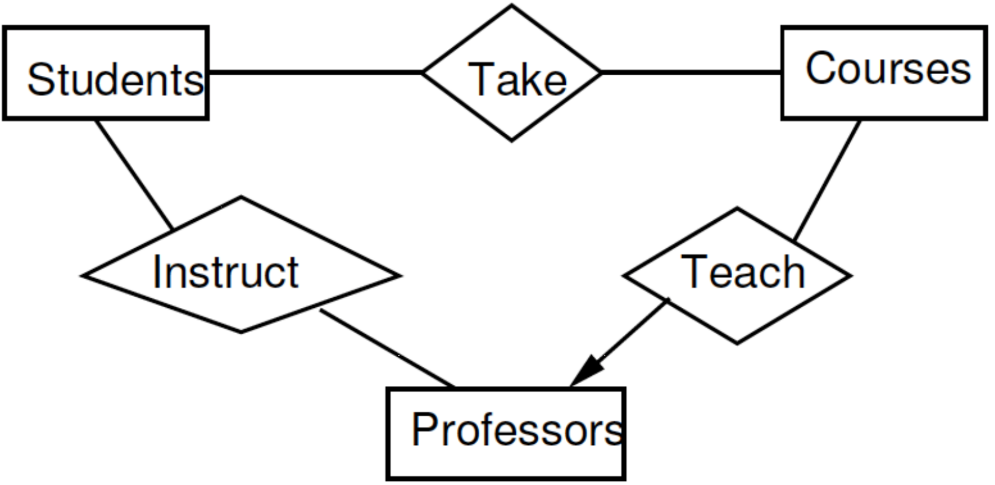
Select the Right Relationships
Do not add unnecessary relationships
It may be possible to deduce one relationship from another
Do we need the relationship Instruct between Professors and Students?

Slide 146
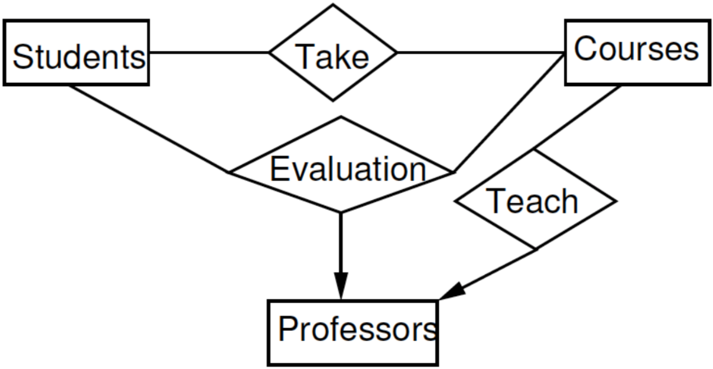
Select the Right Relationships
Do we need the relationships Take and Teach?

Slide 147
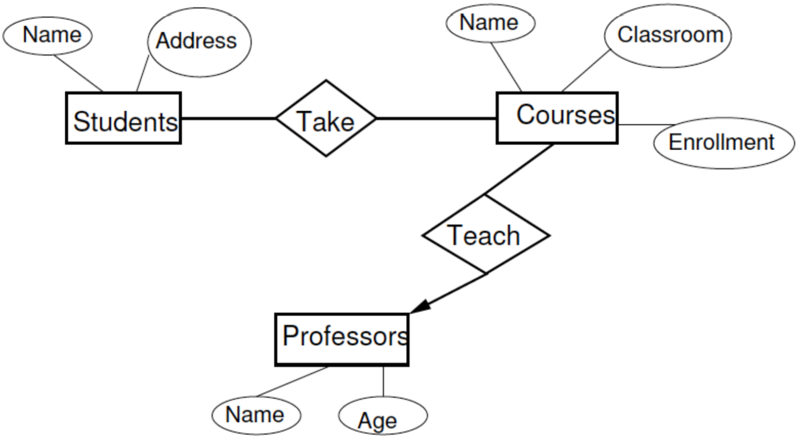
Select the right kind of element
Attribute or Entity or Relationship
Can we make Professor an attribute of Courses and remove the relationship Teach?

Slide 148
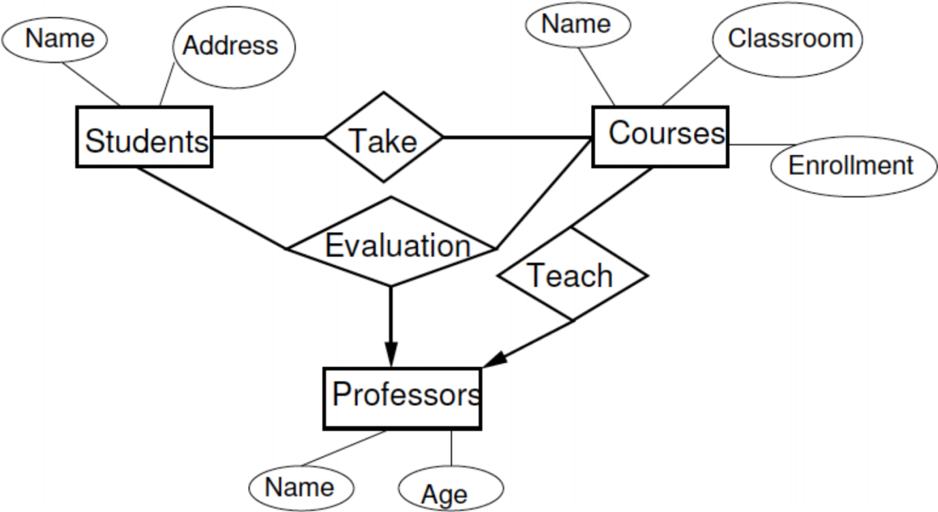
Select the right kind of element
Attribute or Entity or Relationship
What about this?

Slide 149
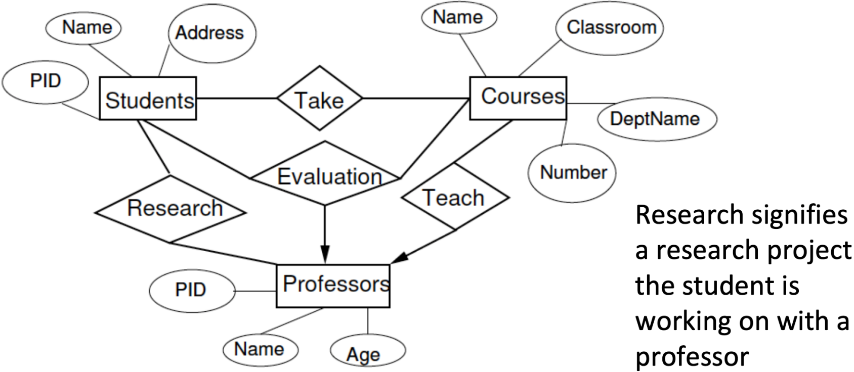
Select the right kind of element
Attribute or Entity or Relationship
What about this?

Slide 150
Alternative diagrammatic notations
ER/EER diagrams are a specific notation for displaying the concepts of the model diagrammatically
DB design tools use many alternative notations for the same or similar concepts
One popular alternative notation uses UML class diagrams
see next slides for UML class diagrams and other alternative notations

Slide 151
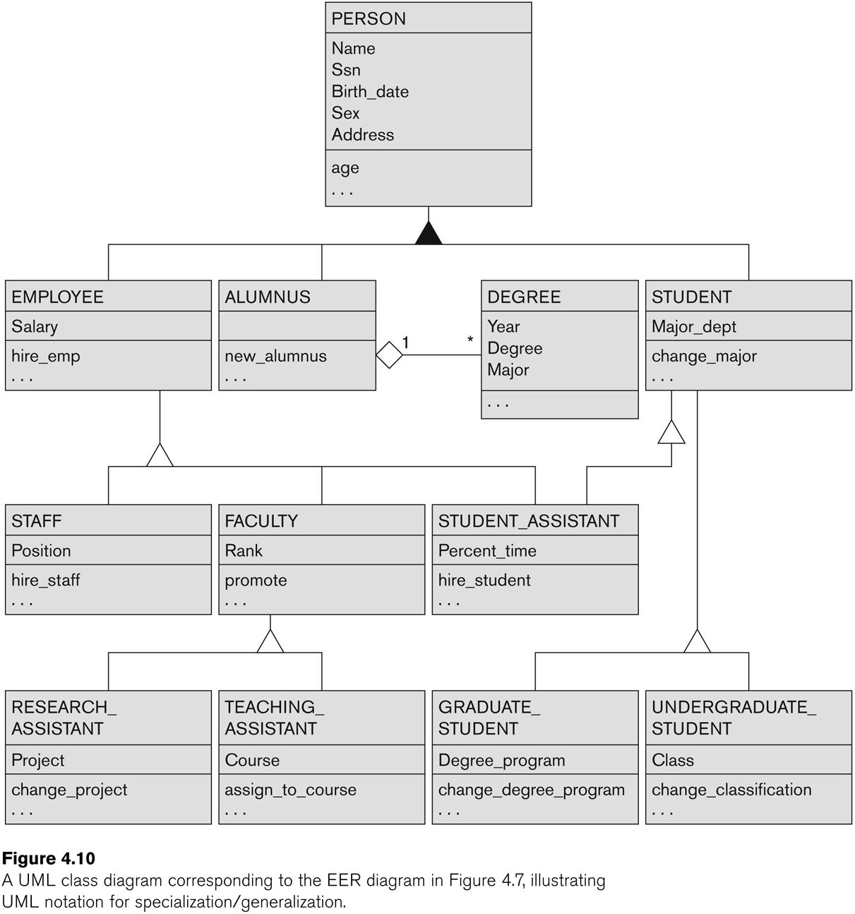
UML Example for Displaying Specialization / Generalization

Slide 152
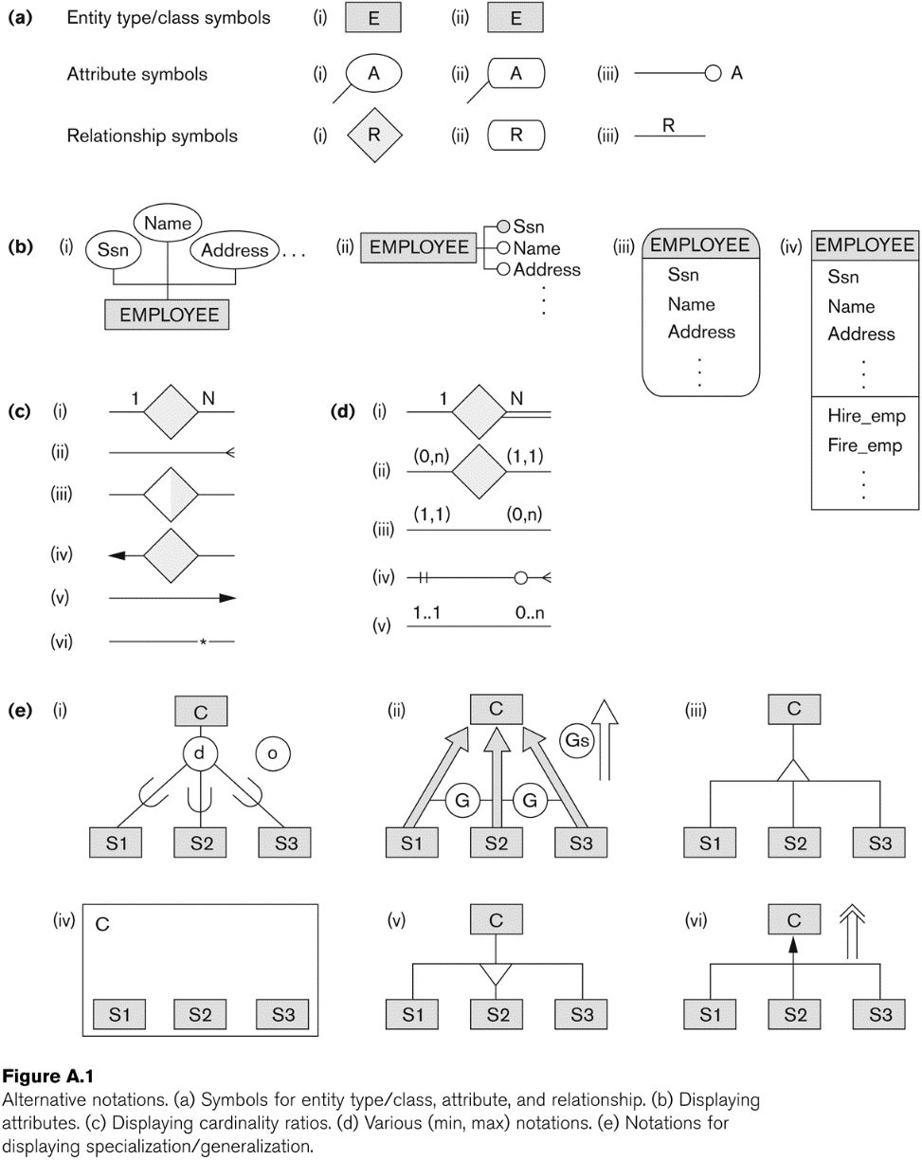
Other alternative diagrammatic notations
Symbols for entity type/class, attribute, and relationship.

Slide 153
Other alternative diagrammatic notations
(b) Displaying attributes.
(c) Displaying cardinality ratios.
(d) Various (min, max) notations.

Slide 154
Other alternative diagrammatic notations
Notations for displaying specialization/generalization

Slide 155
Other alternative diagrammatic notations
(a) Symbols for entity type/class, attribute, and relationship.
(b) Displaying attributes.
(c) Displaying cardinality ratios.
(d) Various (min, max) notations.
(e) Notations for displaying specialization/generalization

Slide 156
Knowledge Representation (KR)-1
The modeling concepts that we described quite specifically in our presentation of the ER and EER models.
This terminology is not only used in conceptual data modeling but also in artificial intelligence literature when discussing knowledge representation (KR).
This section discusses the similarities and differences between conceptual modeling and knowledge representation, and introduces some of the alternative terminology and a few additional concepts.

Slide 157
Knowledge Representation (KR)-2
Deals with modeling and representing a certain domain of knowledge.
Typically done by using some formal model of representation and by creating an Ontology
An ontology for a specific domain of interest describes a set of concepts and interrelationships among those concepts
An Ontology serves as a “schema” which enables interpretation of the knowledge in a “knowledge-base”

Slide 158
Ontologies
Use conceptual modeling and other tools to develop “a specification of a conceptualization”
Specification refers to the language and vocabulary (data model concepts) used
Conceptualization refers to the description (schema) of the concepts of a particular field of knowledge and the relationships among these concepts
Many medical, scientific, and engineering ontologies are being developed as a means of standardizing concepts and terminology

Slide 159
KR versus Data Models
COMMON FEATURES
Both use similar set of abstractions – classification, aggregation, generalization, and identification.
Both provide concepts, relationships, constraints, operations and languages to represent knowledge and model data
DIFFERENCES:
KR has broader scope: tries to deal with missing and incomplete knowledge, default and common-sense knowledge etc.

Slide 160
KR versus Data Models
DIFFERENCES (continued):
KR schemes typically include rules and reasoning mechanisms for inferencing
Most KR techniques involve data and metadata. In data modeling, these are treated separately
KR is used in conjunction with artificial intelligence systems to do decision support applications
For more details on spatial, temporal and multimedia data modeling, see Chapter 26. For details on use of Ontologies see Sections 27.4.3 and 27.7.4.

Slide 161
Summary
Introduced the EER model concepts
Class/subclass relationships
Specialization and generalization
Inheritance
Constraints on EER schemas
EER diagrams and alternative notations were presented
Knowledge Representation and Ontologies were introduced and compared with Data Modeling

Slide 162
Review Questions
How does a category differ from a regular shared subclass? What is a category used for? Illustrate your answer with examples.
Discuss the main differences between the notation for EER schema diagrams and UML class diagrams by comparing how common concepts are represented in each.
List the various data abstraction concepts and the corresponding modeling concepts in the EER model.
What aggregation feature is missing from the EER model? How can the EER model be further enhanced to support it?
What are the main similarities and differences between conceptual database modeling techniques and knowledge representation techniques? 4.15. Discuss the similarities and differences between an ontology and a database schema.

Slide 163
Exercise(1)
Design an EER schema for a database application that you are interested in. Specify all constraints that should hold on the database. Make sure that the schema has at least
five entity types,
four relationship types,
a weak entity type,
a superclass/subclass relationship,
a category, and
an n-ary (n > 2) relationship type.

Slide 164
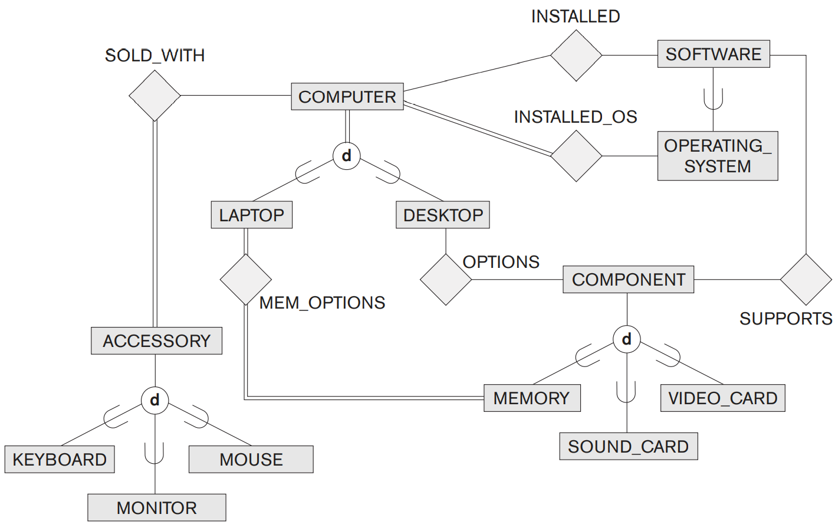
Exercise(2)
Consider the following EER diagram that describes the computer systems at a company. Provide your own attributes and key for each entity type. Supply max cardinality constraints justifying your choice. Write a complete narrative description of what this EER diagram represents.

Slide 165


Exercise(3)
Which of the following EER diagrams is/are incorrect and why? State clearly any assumptions you make.
c.

Slide 166
Exercise(4)
Place a checkmark in one column in each row to indicate the relationship between the far left and far right columns.
Entity Set | Has a Relationship with | Has an Attribute that is | Is a Specialization of | Is a Generalization of Entity | Set or Attribute
MOTHER |  |  |  |  | PERSON
DAUGHTER |  |  |  |  | MOTHER
STUDENT |  |  |  |  | PERSON
STUDENT |  |  |  |  | Student_ID
SCHOOL |  |  |  |  | STUDENT
SCHOOL |  |  |  |  | CLASS_ROOM
ANIMAL |  |  |  |  | HORSE
HORSE |  |  |  |  | Breed
HORSE |  |  |  |  | Age
EMPLOYEE |  |  |  |  | SSN
FURNITURE |  |  |  |  | CHAIR
CHAIR |  |  |  |  | Weight
HUMAN |  |  |  |  | WOMAN

